Slide 2
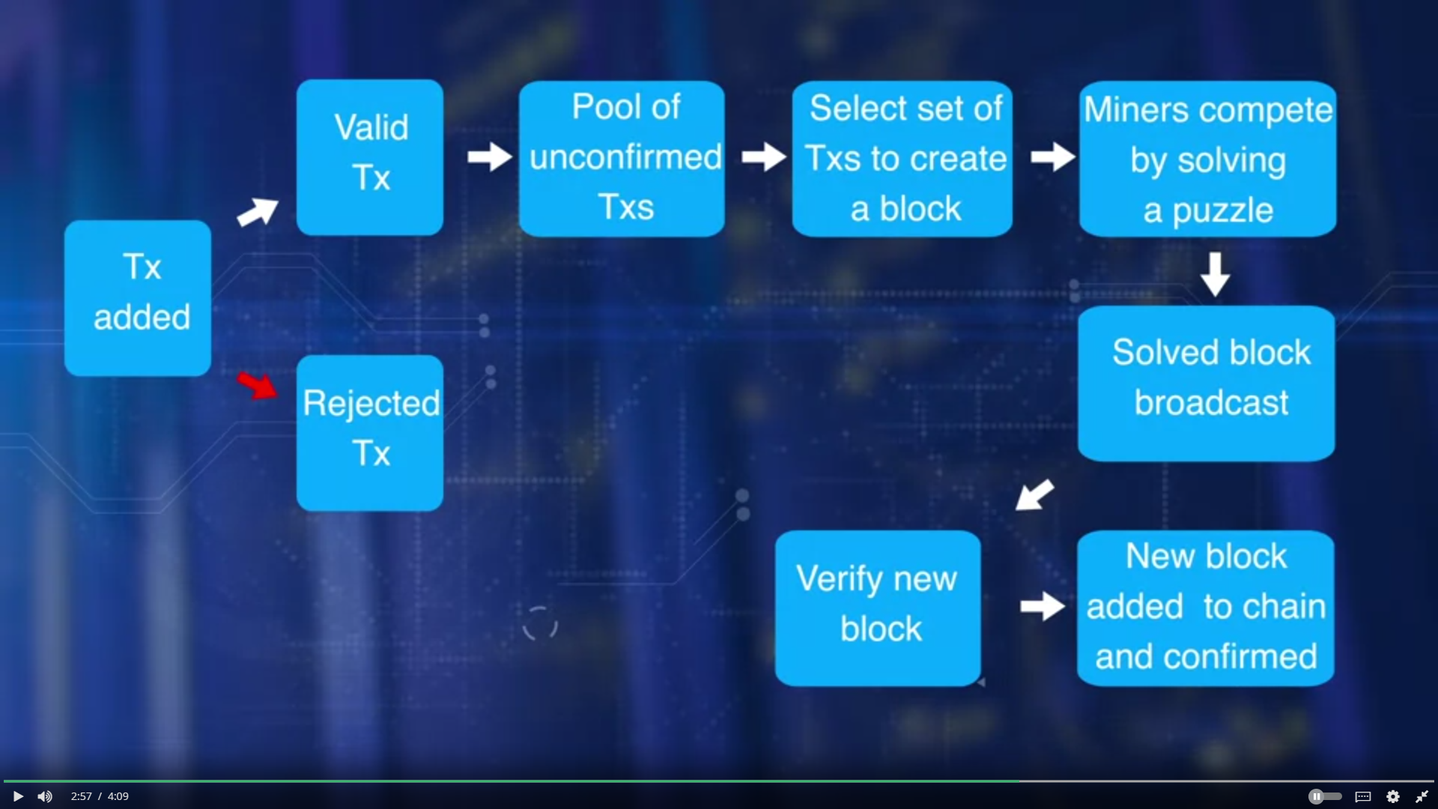
Week 1: Basic Operations

Slide 3
Week 1: Basic Operations
Operations in the decentralized network include :
validation transactions
gathering the transactions for a block,
broadcasting the ballot transactions in the block,
and consensus on the next block creation,
and chaining the blocks to form an immutable record.

Slide 4
Week 1: Basic Operations
Miners, who pick on added work or computation:
to verify transactions, broadcast transaction,
compete to claim the right to create a block,
work on reaching consensus by validating the block,
broadcasting the newly created block, and confirming transactions.
Transaction validation is carried out independently by all miners. The process involves validation of more than 20 criteria, including size, syntax, et cetera.
Some of these criteria are: Referenced Input Unspent Transaction Output, UTXOs are valid reference output UTXOs are correct, reference input amount and output amount matched sufficiently, invalid transactions are rejected and will not be broadcast

Slide 5
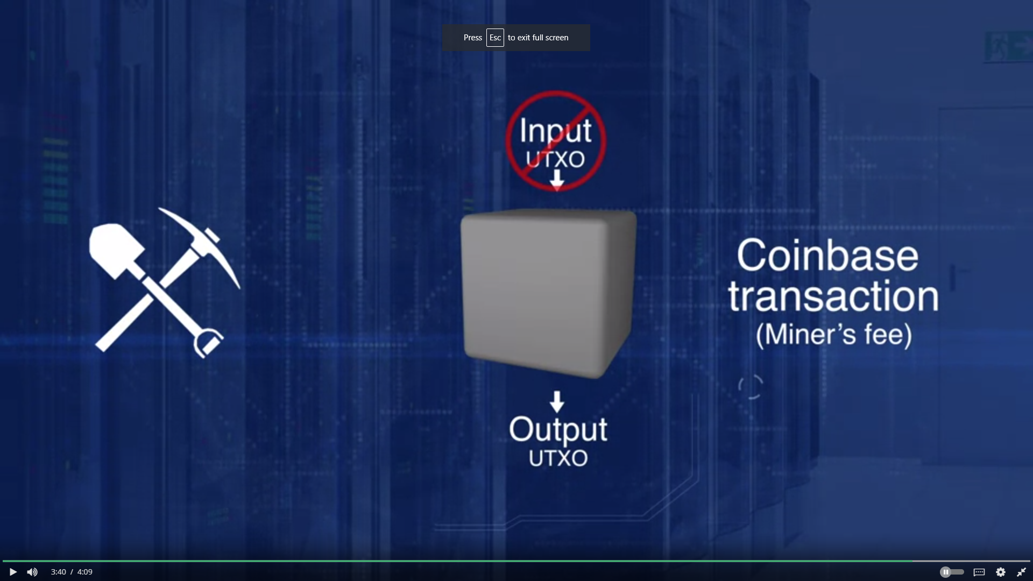
Week 1: Basic Operations
The algorithm for consensus is called proof-of -work protocol, since it involves work a computational power to solve the puzzle and to claim the right to form the next block. Transaction zero, index zero of the confirmed block is created by the miner of the block. It has a special UTXO and does not have any input UTXO. It is called the coinbase transaction that generates a minor's fees for the block creation. Currently, the minor's fees is 12.5 BTC for a bitcoin.
To summarize, the main operations in a blockchain are transaction validation and block creation with the consensus of the participants.

Slide 6
Week 1: Basic Operations
Blocks
When a block on the blockchain is opened, the blockchain creates the block hash, a 256-bit number that encodes the following information:
The block version: The Bitcoin client version
The previous block's hash: The hash of the block before the current one
The coinbase transaction: The first transaction in the block, issuing the bitcoin reward
The block height number: How far away numerically the block is from the first block
Merkelroot: A 256-bit number that stores the information about all previous blocks
Timestamp: The time and date the block was opened
The target in bits: The network target
The nonce: A randomly-generated 32-bit number
Queued transactions are entered into the block, the block is closed, and the blockchain creates the hash. Each block contains information from the previous blocks, so the blockchain cannot be altered because each block is "chained" to the one before it. Blocks are validated and opened by a process called mining.

Slide 7
Week 1: Basic Operations
How Do Bitcoin Nodes Verify Transactions?
A Bitcoin nodes run series of checks on a transaction as it arrives before it is verified. Nodes are built to own transaction pools to verify transactions. The conditions for verification can change from time to time. However, they typically fall within the points listed below.
What Do Bitcoin Nodes Check Before Verifying a Transaction?
1. They check to see if the data structure and the syntax of the transaction are correct.
2. They check to see if the transaction is above 1 MB.
3. They confirm that the outputs and inputs have values are not be more than 21 million or less than 0.
4. They check the locktime to confirm that it is less than the number allowed.
5. They confirm that the unlocking scripts for the inputs are verified against that of the output.
6. They check to see if the transaction size is more than or up to 100 bytes.
7. They reject any transaction when the value is too low for an empty block.
8. They reject the transactions if the input value is not as high as the output value.
9. They confirm that the input value falls within the required range.
10. They make sure that all Coinbase transactions have a maturity of at least 100 confirmations.
11. The output for each input must exit. If it has been spent, the transaction will be rejected.
12. They confirm that the locking script and the standard format match.
13. They confirm that a matching script exists.
14. The Bitcoin nodes make sure that the signatures are not above the signature limit.
15. They verify that the script for unlocking can push numbers onto the stack.
16. They throw any transaction that is missing into the orphan transaction pool.
The Bitcoin nodes ensure that fraudsters do not infiltrate the system by making sure each transaction meets all the requirements before it is verified. Any transaction that doesn’t meet the requirements is rejected.

Slide 8
Week 1: Basic Operations
There are generally three categories of blockchain-like database applications: Bitcoin Nodes Verify Transactions?
Public blockchains: a public blockchain is a blockchain that anyone in the world can read, anyone in the world can send transactions to and expect to see them included if they are valid, and anyone in the world can participate in the consensus process - the process for determining what blocks get added to the chain and what the current state is. As a substitute for centralized or quasi-centralized trust, public blockchains are secured by cryptoeconomics - the combination of economic incentives and cryptographic verification using mechanisms such as proof of work or proof of stake, following a general principle that the degree to which someone can have an influence in the consensus process is proportional to the quantity of economic resources that they can bring to bear. These blockchains are generally considered to be "fully decentralized".
Consortium blockchains: a consortium blockchain is a blockchain where the consensus process is controlled by a pre-selected set of nodes; for example, one might imagine a consortium of 15 financial institutions, each of which operates a node and of which 10 must sign every block in order for the block to be valid. The right to read the blockchain may be public, or restricted to the participants, and there are also hybrid routes such as the root hashes of the blocks being public together with an API that allows members of the public to make a limited number of queries and get back cryptographic proofs of some parts of the blockchain state. These blockchains may be considered "partially decentralized".
Fully private blockchains: a fully private blockchain is a blockchain where write permissions are kept centralized to one organization. Read permissions may be public or restricted to an arbitrary extent. Likely applications include database management, auditing, etc internal to a single company, and so public readability may not be necessary in many cases at all, though in other cases public auditability is desired.

Slide 9
Week 1: Basic Operations
Compared to public blockchains, private ones have a number of advantages:
The consortium or company running a private blockchain can easily, if desired, change the rules of a blockchain, revert transactions, modify balances, etc. In some cases, eg. national land registries, this functionality is necessary; there is no way a system would be allowed to exist where Dread Pirate Roberts can have legal ownership rights over a plainly visible piece of land, and so an attempt to create a government-uncontrollable land registry would in practice quickly devolve into one that is not recognized by the government itself. Of course, one can argue that one can do this on a public blockchain by giving the government a backdoor key to a contract; the counter-argument to that is that such an approach is essentially a Rube Goldbergian alternative to the more efficient route of having a private blockchain, although there is in turn a partial counter-argument to that that I will describe later.
The validators are known, so any risk of a 51% attack arising from some miner collusion in China does not apply.
Transactions are cheaper, since they only need to be verified by a few nodes that can be trusted to have very high processing power, and do not need to be verified by ten thousand laptops. This is a hugely important concern right now, as public blockchains tend to have transaction fees exceeding $0.01 per tx, but it is important to note that it may change in the long term with scalable blockchain technology that promises to bring public-blockchain costs down to within one or two orders of magnitude of an optimally efficient private blockchain system
Nodes can be trusted to be very well-connected, and faults can quickly be fixed by manual intervention, allowing the use of consensus algorithms which offer finality after much shorter block times. Improvements in public blockchain technology, such as Ethereum 1.0's uncle concept and later proof of stake, can bring public blockchains much closer to the "instant confirmation" ideal (eg. offering total finality after 15 seconds, rather than 99.9999% finality after two hours as does Bitcoin), but even still private blockchains will always be faster and the latency difference will never disappear as unfortunately the speed of light does not increase by 2x every two years by Moore's law.
If read permissions are restricted, private blockchains can provide a greater level of, well, privacy.

Slide 10
Week 1: Basic Operations
The advantages of public blockchains generally fall into two major categories:
Public blockchains provide a way to protect the users of an application from the developers, establishing that there are certain things that even the developers of an application have no authority to do. From a naive standpoint, it may be hard to understand why an application developer would want to voluntarily give up power and hamstring themselves. However, more advanced economic analysis provides two reasons why, in Thomas Schelling's words, weakness can be a strength. First, if you explicitly make it harder or impossible for yourself to do certain things, then others will be more likely to trust you and engage in interactions with you, as they are confident that those things are less likely to happen to them. Second, if you personally are being coerced or pressured by another entity, then saying "I have no power to do this even if I wanted to" is an important bargaining chip, as it discourages that entity from trying to compel you to do it. A major category of pressure or coercion that application developers are at risk of is that by governments, so "censorship resistance" ties strongly into this kind of argument.
Public blockchains are open, and therefore are likely to be used by very many entities and gain some network effects. To give a particular example, consider the case of domain name escrow. Currently, if A wants to sell a domain to B, there is the standard counterparty risk problem that needs to be resolved: if A sends first, B may not send the money, and if B sends first then A might not send the domain. To solve this problem, we have centralized escrow intermediaries, but these charge fees of three to six percent. However, if we have a domain name system on a blockchain, and a currency on the same blockchain, then we can cut costs to near-zero with a smart contract: A can send the domain to a program which immediately sends it to the first person to send the program money, and the program is trusted because it runs on a public blockchain. Note that in order for this to work efficiently, two completely heterogeneous asset classes from completely different industries must be on the same database - not a situation which can easily happen with private ledgers. Another similar example in this category is land registries and title insurance, although it is important to note that another route to interoperability is to have a private chain that the public chain can verify, btcrelay-style, and perform transactions cross-chain.

Slide 11
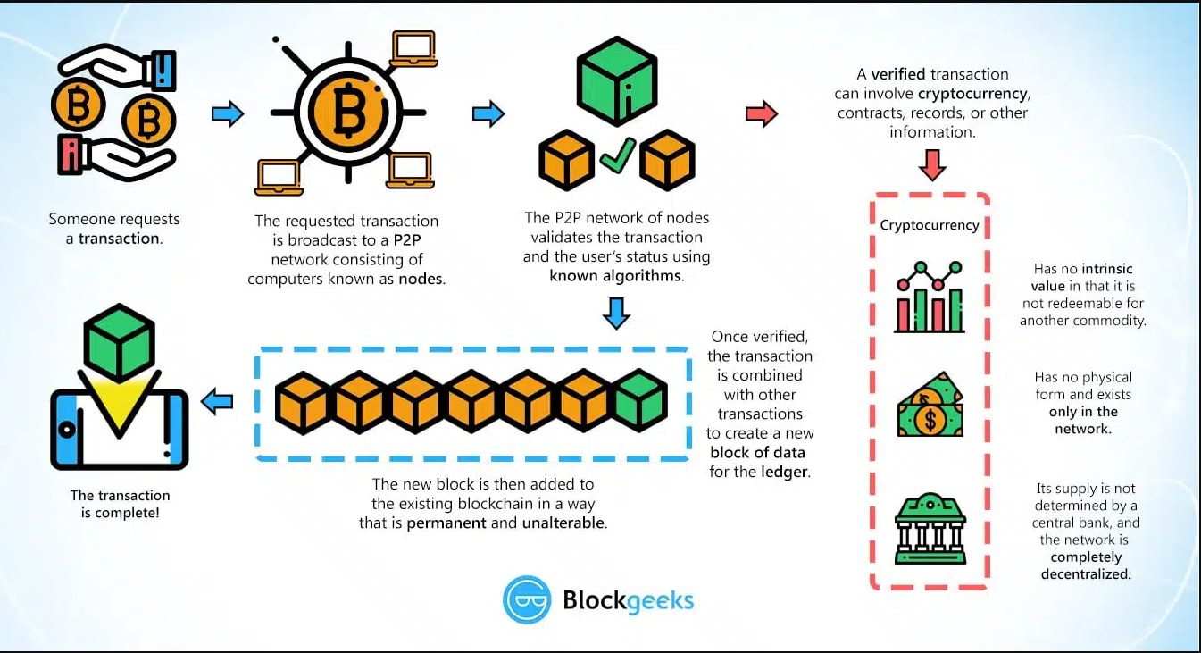
Week 1: Basic Operations

Slide 12
Week 1: Basic Operations
Only miners can confirm transactions. This is their job in a cryptocurrency-network. They take transactions, stamp them as legit and spread them in the network. After a transaction is confirmed by a miner, every node has to add it to its database. It has become part of the blockchain.
Bitcoins can only be created if miners solve a cryptographic puzzle. Since the difficulty of this puzzle increases the amount of computer power the whole miner’s invest, there is only a specific amount of cryptocurrency token that can be created in a given amount of time. This is part of the consensus no peer in the network can break.
Basically, cryptocurrencies are entries about token in decentralized consensus-databases. They are called CRYPTOcurrencies because the consensus-keeping process is secured by strong cryptography. Cryptocurrencies are built on cryptography. They are not secured by people or by trust, but by math. It is more probable that an asteroid falls on your house than that a bitcoin address is compromised.

Slide 13
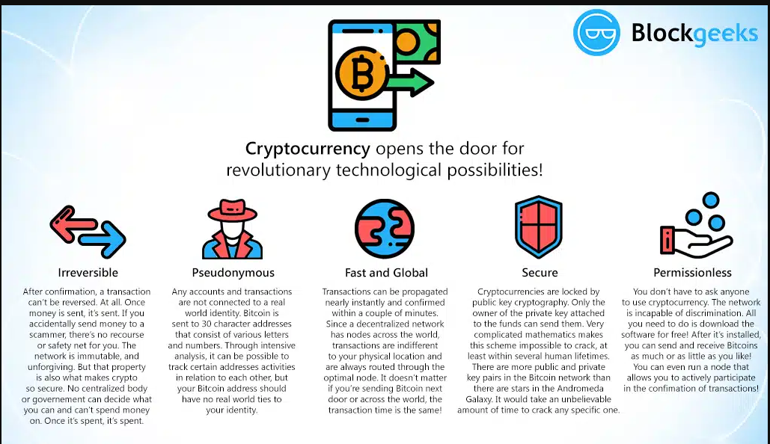
Week 1: Basic Operations

Slide 14
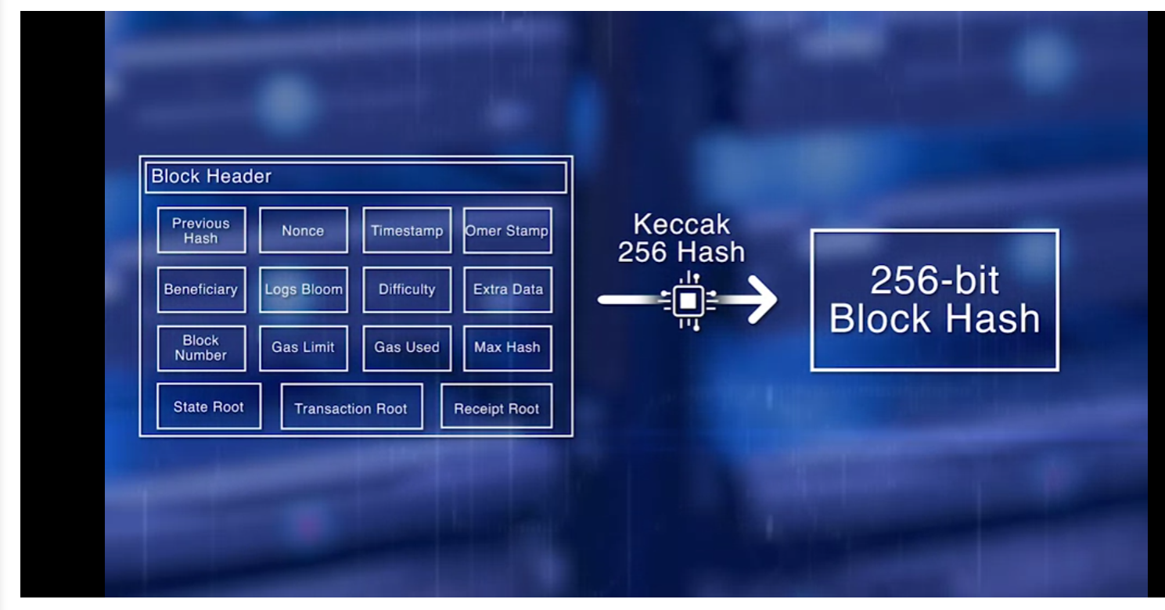
Week 3: Securing Blockchain

Slide 15
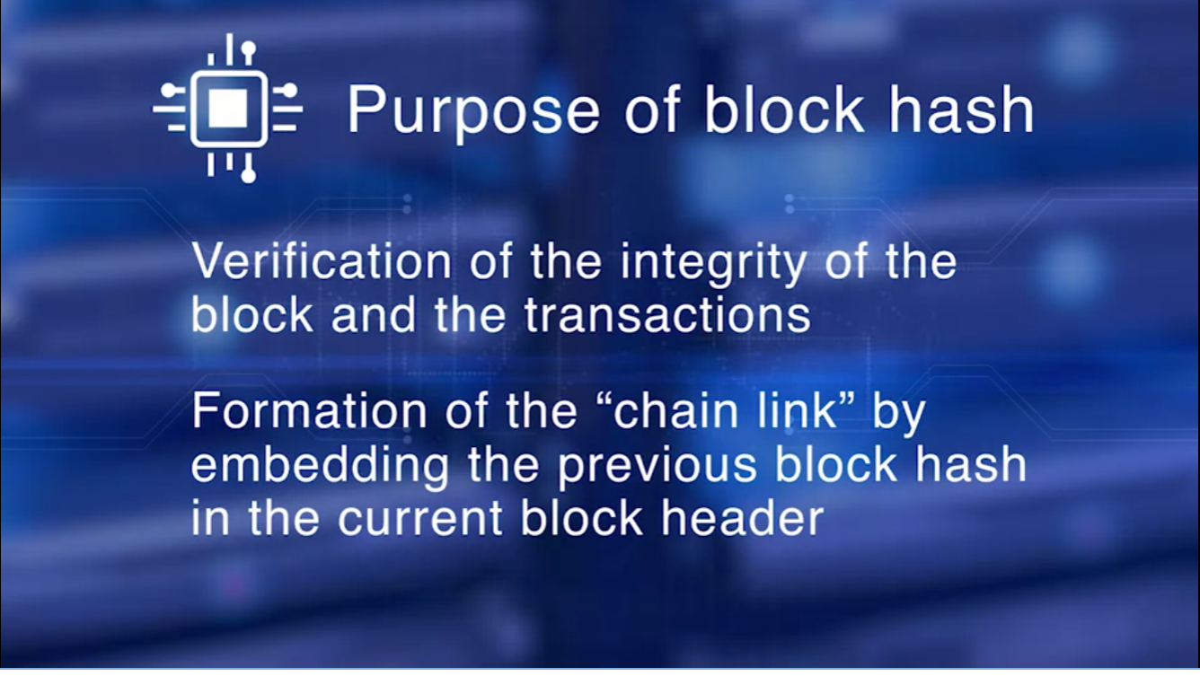
Week 3: Securing Blockchain

Slide 16
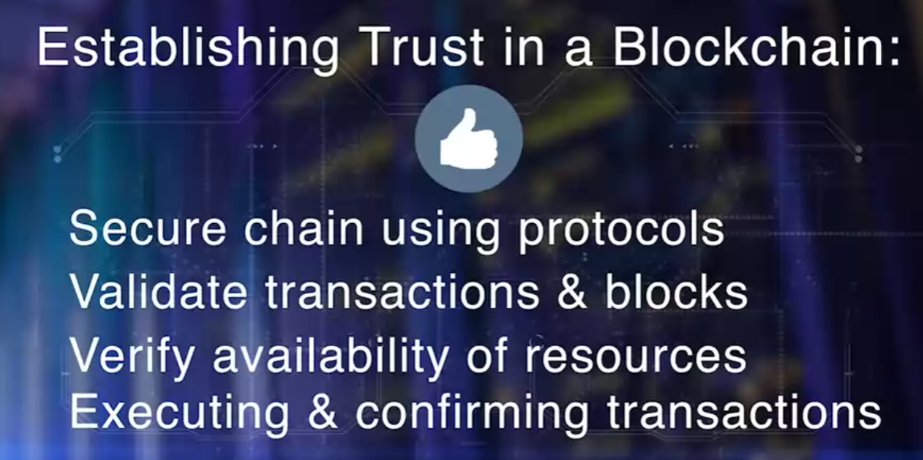
Week 4: Trust Essentials
Trust in a decentralized blockchain is also about securing, validating, verifying, and making sure resources needed for transaction execution are available.
This is accomplished by securing the chain using specific protocols, validating the transaction and blocks for tamper proofing, verifying the availability of resources for transactions, and executing and confirming the transactions.

Slide 17
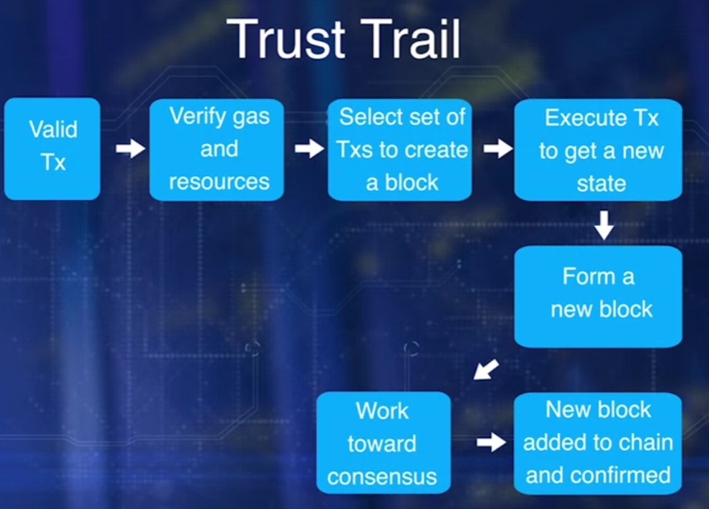
Week 4: Trust Essentials
The Trust Trail is defined by these operations:
validate transaction,
verify gas and resources,
gather transactions,
execute transaction to get a new state,
form the block, work towards consensus,
finalize the block by the bidder,
and everyone add the block to their chain and confirm the transactions.

Slide 18
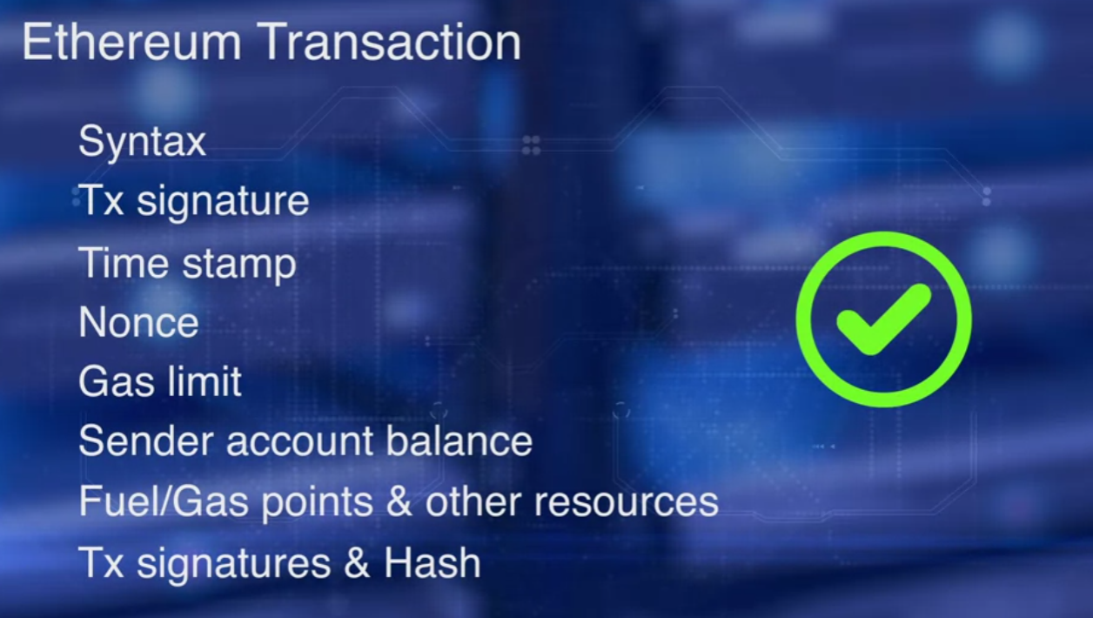
Week 4: Trust Essentials
Step 1 and 2:
In the case of a Bitcoin, there are about 20 criteria that have to be checked before a transaction is validated, as discussed in module one, similarly in the case of Ethereum transaction.
The syntax, the transaction signature, time stamp, nonce, gas limit, and sender account balance are validated before execution. The fuel, or gas points, and other resources available for smart contract execution, are also validated. Transaction signatures and hash are also verified.

Slide 19
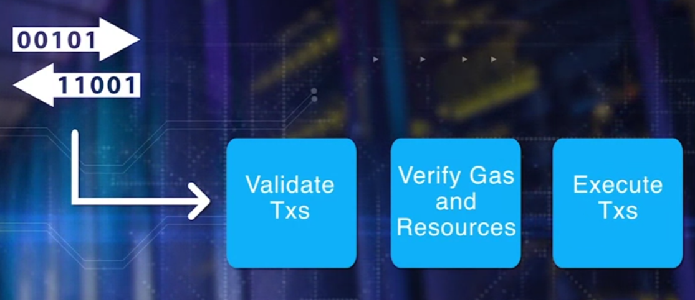
Week 4: Trust Essentials
Step 3:
Merkle tree hash of the validated transactions is computed. In Ethereum this is the transaction root of the block header.
All miners execute the transaction for either transfer, as well as for execution of smart contracts. The state resulting from transaction execution are used in computing the Merkle tree hash of the states, the state root of the block header. The receipt root of the block header is also computed.

Slide 20
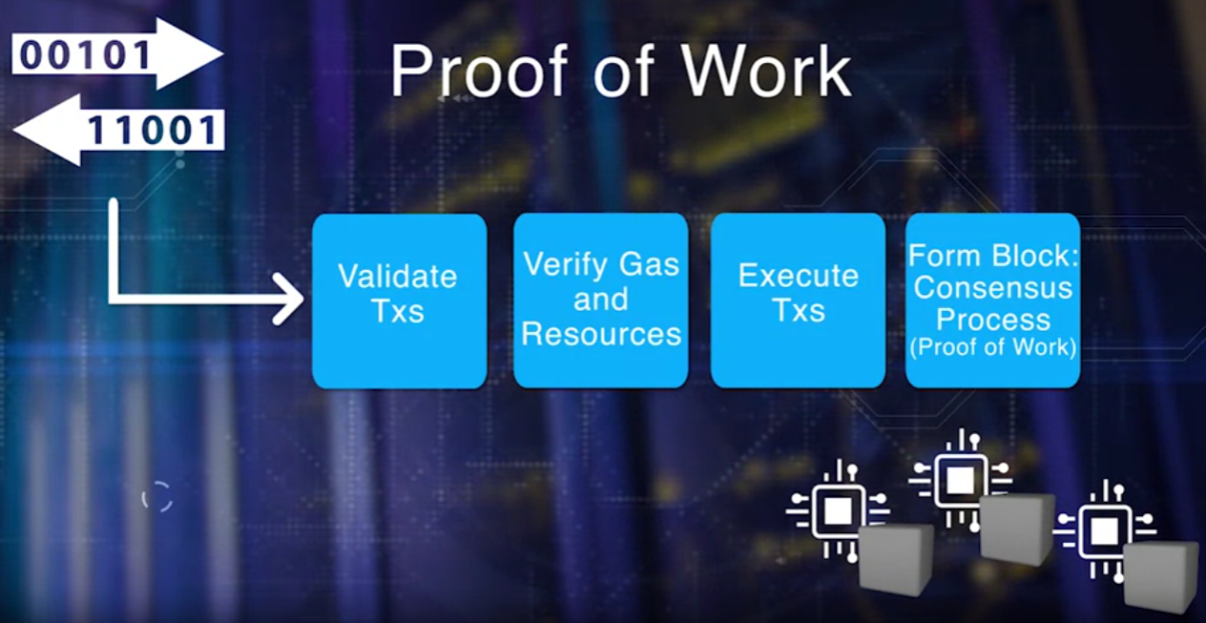
Week 4: Trust Essentials
Step 4:
A secure chain is a single main chain with a consistent state. Every valid block added to this chain, adds to the trust level of the chain. The miners are vying, are competing to add their block to the chain. What if everyone wants to add their candidate block to the chain? Each of the candidate blocks is by a competing miner. Which is the next block to be added to the chain? Can they agree on the next block? Is there a method or a protocol to choose the next block?
Proof of Work uses hashing.

Slide 21
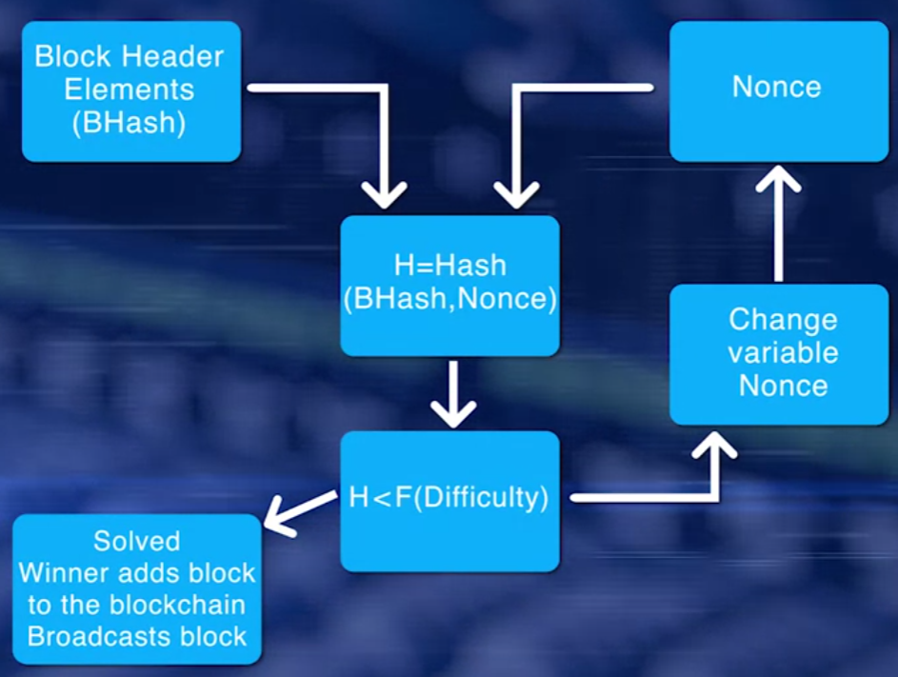
Week 4: Trust Essentials
Step 4: Proof of Work
This is from the point of view of the miner. First, compute the hash of the block header elements that is a fixed value, and a nonce that is a variable. If hash value is less than 2 par 128 for bitcoin, and less than function of difficulty for Ethereum, the puzzle has been solved.
If it has not been solved, repeat the process after changing the nonce value. If the puzzle has been solved, broadcast the winning block that will be verified by other miners. Non-winning miner nodes add the new block to the local copy of the chain, and move on to working on the next block. The winner gets an incentive for creating the block.

Slide 22
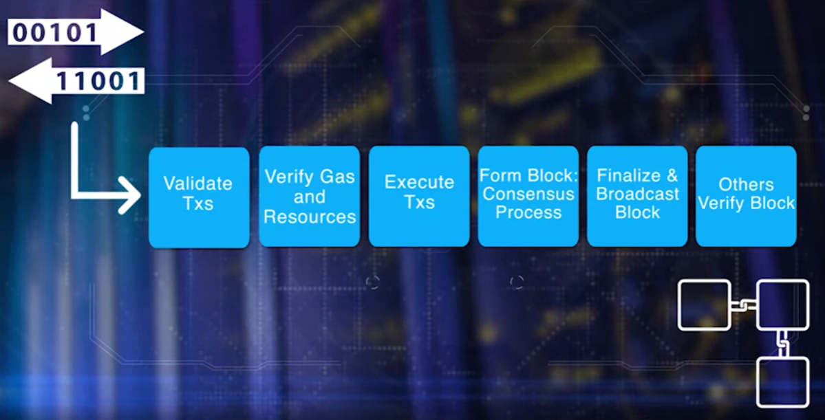
Week 4: Trust Essentials
Step 4: Proof of Work Broadcasting
If the puzzle has been solved, broadcast the winning block that will be verified by other miners. Non-winning miner nodes add the new block to the local copy of the chain, and move on to working on the next block. The winner gets an incentive for creating the block. Proof of Work is a consensus protocol used by bitcoin block chain and also by the current version of Ethereum.
The protocol may be the same, the implementations in these two block chains are different. Many other approaches such as Proof of Stake, Proof of Elapsed Time have been proposed. This is a hotly debated area among the developers of blockchain, and you can contribute to it.

Slide 23
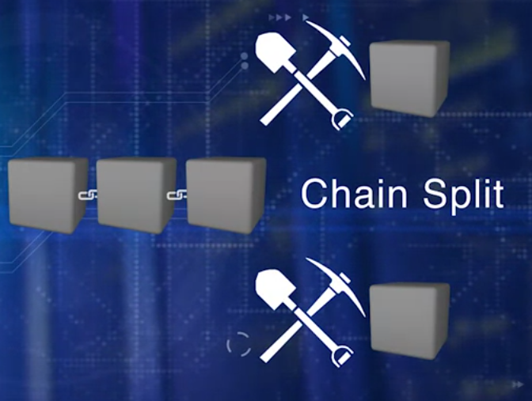
Week 4: Trust Essentials
Robustness
Trust us not only about executing regular operations correctly but also about managing exception satisfactory. Robustness is the ability to satisfactorily manage exceptional situations.
This lesson is about some of the exceptions that may occur during the block chaining process.
Chain Split: what if more than one miner solves the consensus puzzle where it close in time to each other?
Double Spending: What if more than one transaction references as input the same digital asset?

Slide 24
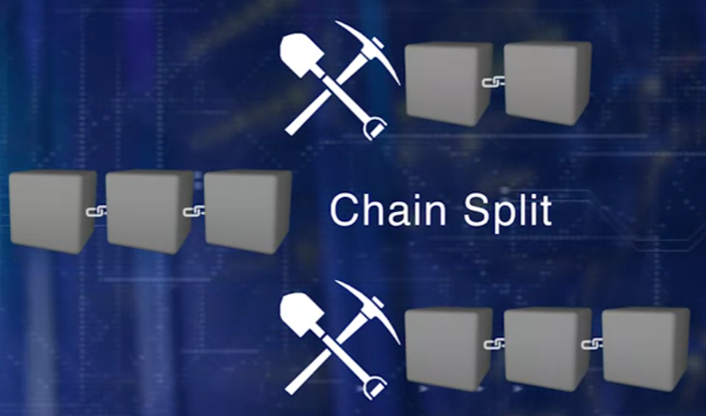
Week 4: Trust Essentials
Chain Split: what if more than one miner solves the consensus puzzle where it close in time to each other?
Here, you see two miners have solved the consensus puzzle very close to each other. Bitcoin protocol allows this chain split or two chains for the next cycle. One led by each of the competing blocks. The probability that the next block will happen at the same time in both these chains is extremely low. So the winner of the next cycle for block creation consolidates one of the chains and that chain becomes the accepted chain. In this case, the newest block is added to the main chain. Now this chain is the longest and the valid main chain. The transaction in the other blocks are returned to the unconfirmed pool. Summarizing with a very low probability, the main chain may split but if it does, the bitcoin protocol has methods to consolidate it to a single chain within a cycle. Etherium handles more than one person we know by allowing Omar or Runner-Up blocks and allocating a small incentive for these Runner-Up blocks. This incentive model helps in keeping the chains secure. New blocks are added only to the mainchain and not to the Runner-Up chains. That are Runner-up blocks are maintained for six more blocks after they were added.

Slide 25

Week 4: Trust Essentials
Double Spending: What if more than one transaction references as input the same digital asset?
In a decentralized network, like a blockchain, there is no intermediary. We need a policy and an automatic deterministic way to handle this situation. A policy for handling transaction and double spending in Bitcoin is to allow the first transaction that reference the digital asset and reject the rest of the transaction that reference the same digital asset.
In Ethereum, a combination of account number and a global nonce is used to address the doublet spending issue. Every time a transaction is initiated by an account, a global nonce is included in the transaction. After that, the nonce is incremented. Time stamp on the nonce in the transaction should be unique and verified to prevent any double use of digital asset.
There are many other issues such as difficulty adjustment and hard and soft fork exception that will be discussed in the next lessons in the courses that follow.

Slide 26
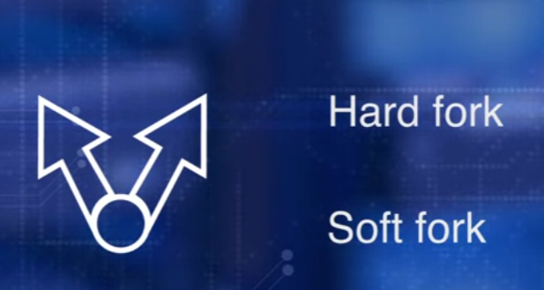
Week 4: Trust Essentials
Fork: Forks are just normal processes in an evolutionary path of the nascent technology enabling a blockchain. If robustness and trust is about managing exceptional situations, hard forks and soft forks are indeed at the front and center. We discussed change split in the last lesson, that is a minor perturbation in the chain. Such situation is handled as a naturally expected occurrence within the block chain.
On the other hand, occasionally, a minor process adjustment has to be carried out typically by bootstrapping a new software to the already running processes. This is soft fork. For example, the scrypt concept in Bitcoin was introduced using this method. You can think of this as a software patch or a bug fix to address an issue.
Hard fork implies a major change in the protocol. For example, the recent change from Ethereum Homestead to Metropolis Byzantium version was a planned hard fork and important note after a hard fork the emerging two chains are incompatible. Please be aware of this. There was an unplanned hard fork in Ethereum protocol, Ethereum Core and Ethereum Classic split, that was enacted to address a critical software issue in a decentralized autonomous organization (DAO). That resulted in a multi-million dollar heist. We'll discuss this in course three where we study decentralized organizations.

Slide 27
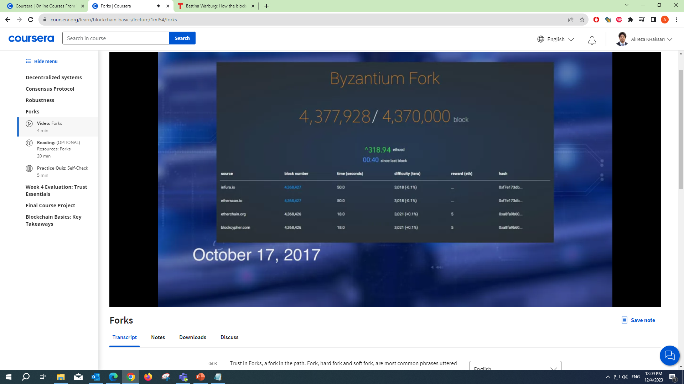
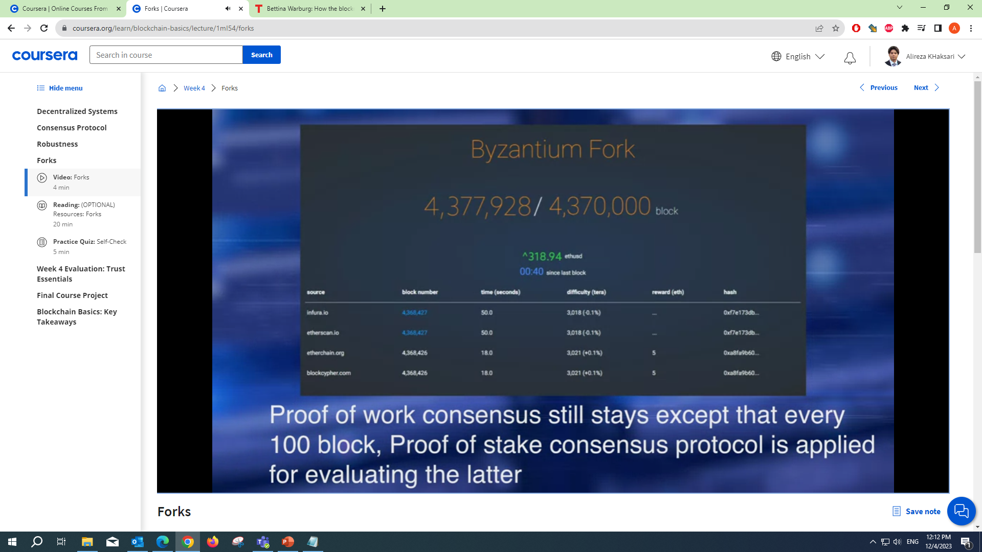
Week 4: Trust Essentials
The Ethereum hard fork was a planned fork. Here are a few Ethereum improvement proposals (EIP) for this fork, parallel processing of transactions. Proof of Work consensus still stays except that every hundred block, Proof of Stake consensus protocol, is applied for evaluating the latter. And minor incentive was reduced from 5 ethers to 3 ethers for block creation. These are just few EIPs. You can look at the documentation for other EIPs.

Slide 28
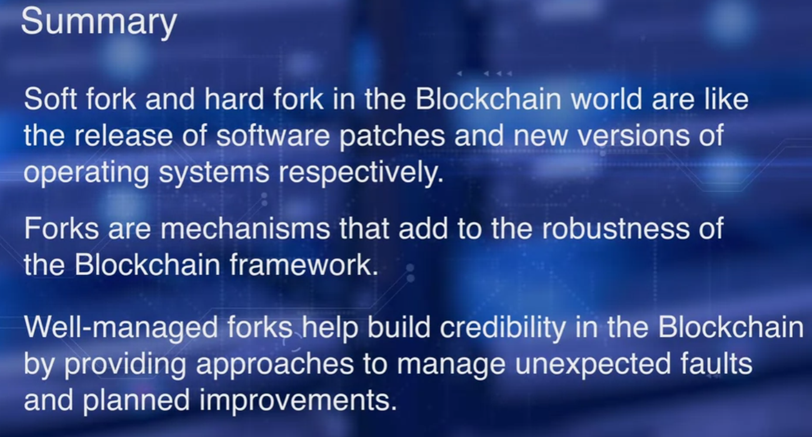
Week 4: Trust Essentials

Slide 29
Course 2 Smart Contract

Slide 30
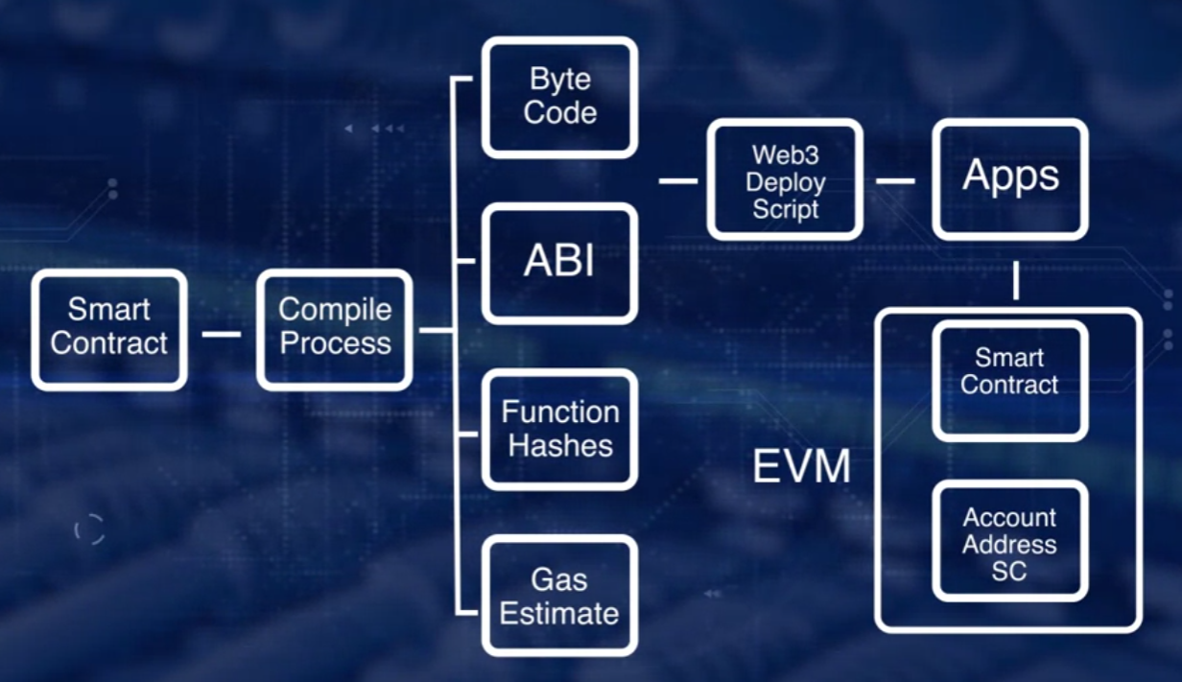
Smart Contract Week1
Remix IDE process
Remix provides us with the Web3 deployment script which contains a bytecode. Application Binary Interface, ABI, and account detail. To deploy the smart contract, we could just execute the script. Once the deployment is done, the address is generated by hashing creator's account number and nonce. To interact with the smart contract, we'll use the smart contract address, ABI definition, and the function hashes.

Slide 31
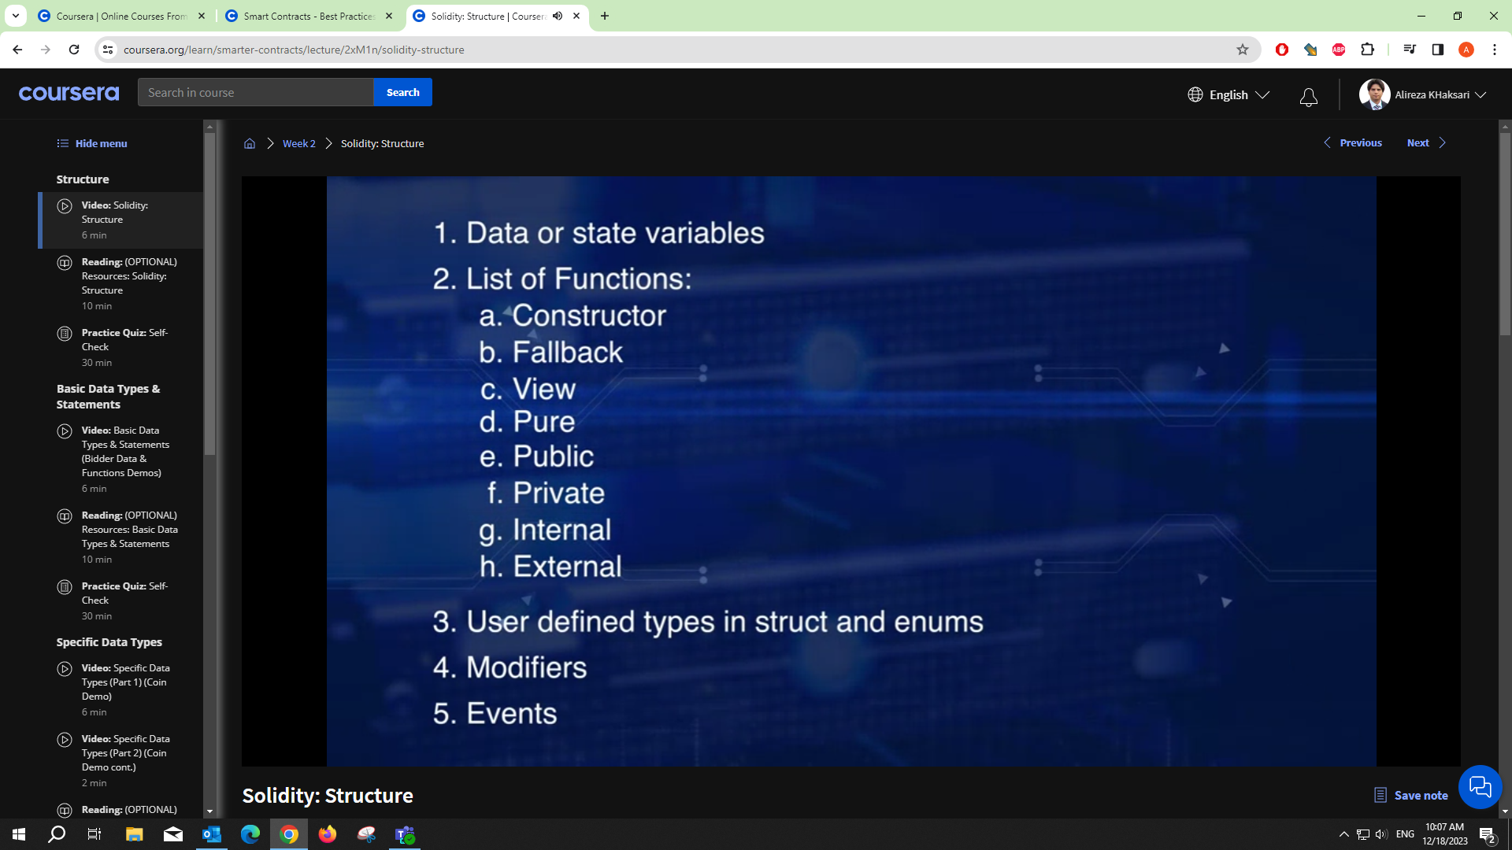
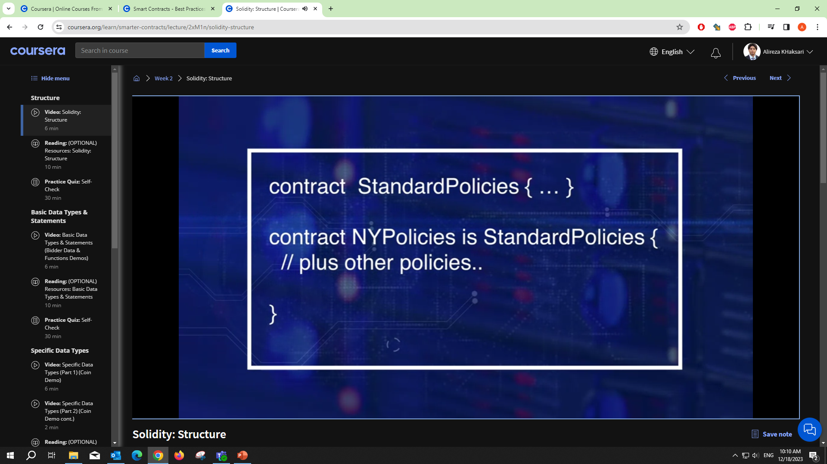
Smart Contract Week1
Solidity Structure
Solidity Inheritance

Slide 32
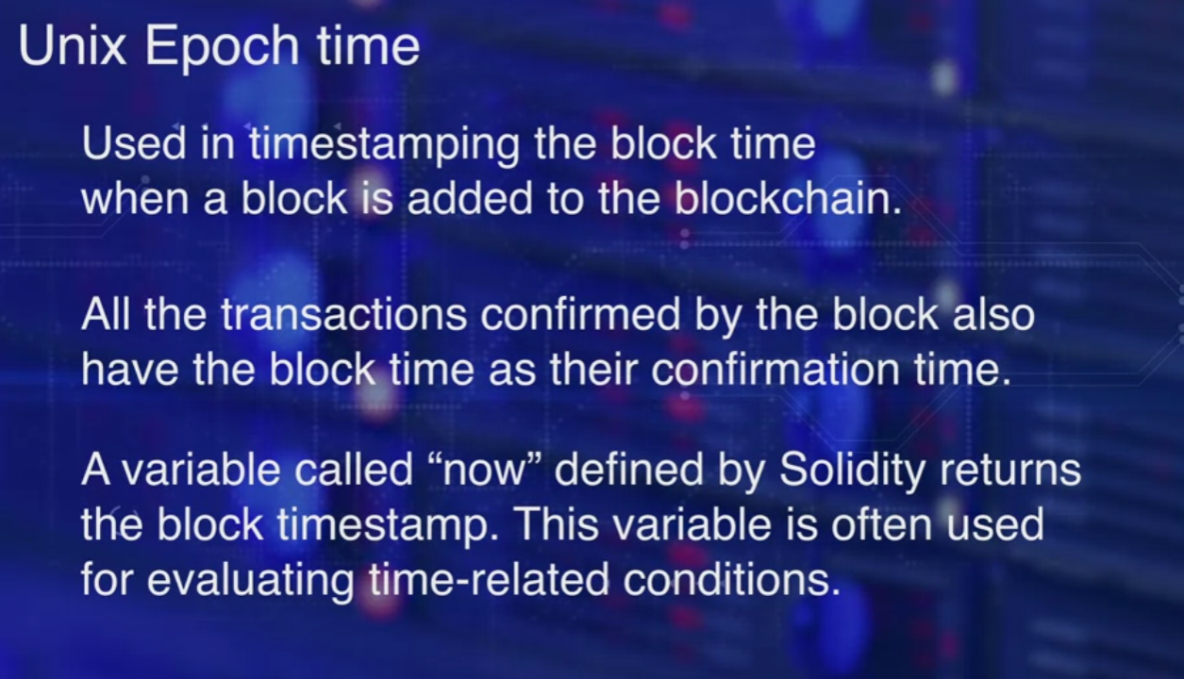
Smart Contract Week1
Epoch Time
When a block is added to the blockchain, all the transaction confirmed by the block also have the same block time as their confirmation time. A variable called "Now" defined by solidity, returns the block timestamp. This variable is often used for evaluating time related conditions. In other words, now variable in a function is not the time at which function transaction was initiated, but it is the time when it was confirmed.
Time is defined as unit time; seconds, minutes, hours, days, weeks and years. Little numbers can be used in specifying time related computations.

Slide 33
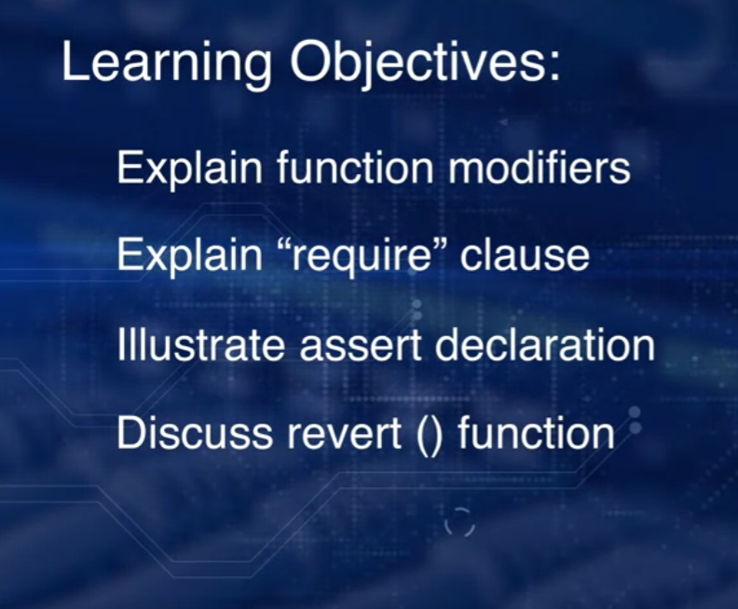
Smart Contract Week2
Modifiers
However, smart contracts often require control over who are what can execute the function, at what time a function needs to be executed, what are the precondition to be met before getting access to the function?
If there are any errors found during the input validation, these have to be handled appropriately.
At the end of the function execution, you may want to assert that certain conditions are met to ensure the integrity of the smart contract. Let's begin with an important feature of solidity, modifiers.

Slide 34
Smart Contract Week2
Modifiers
It is also known as a function modifier since it is specified at the entry to a function and executed before the execution of the function begins. You can think of a modifier as a gatekeeper protecting a function. A modifier typically checks a condition using a require and if the condition failed, the transaction that call the function can be reverted using the revert function. This will completely reject the transaction and revert all its state changes.

Slide 35
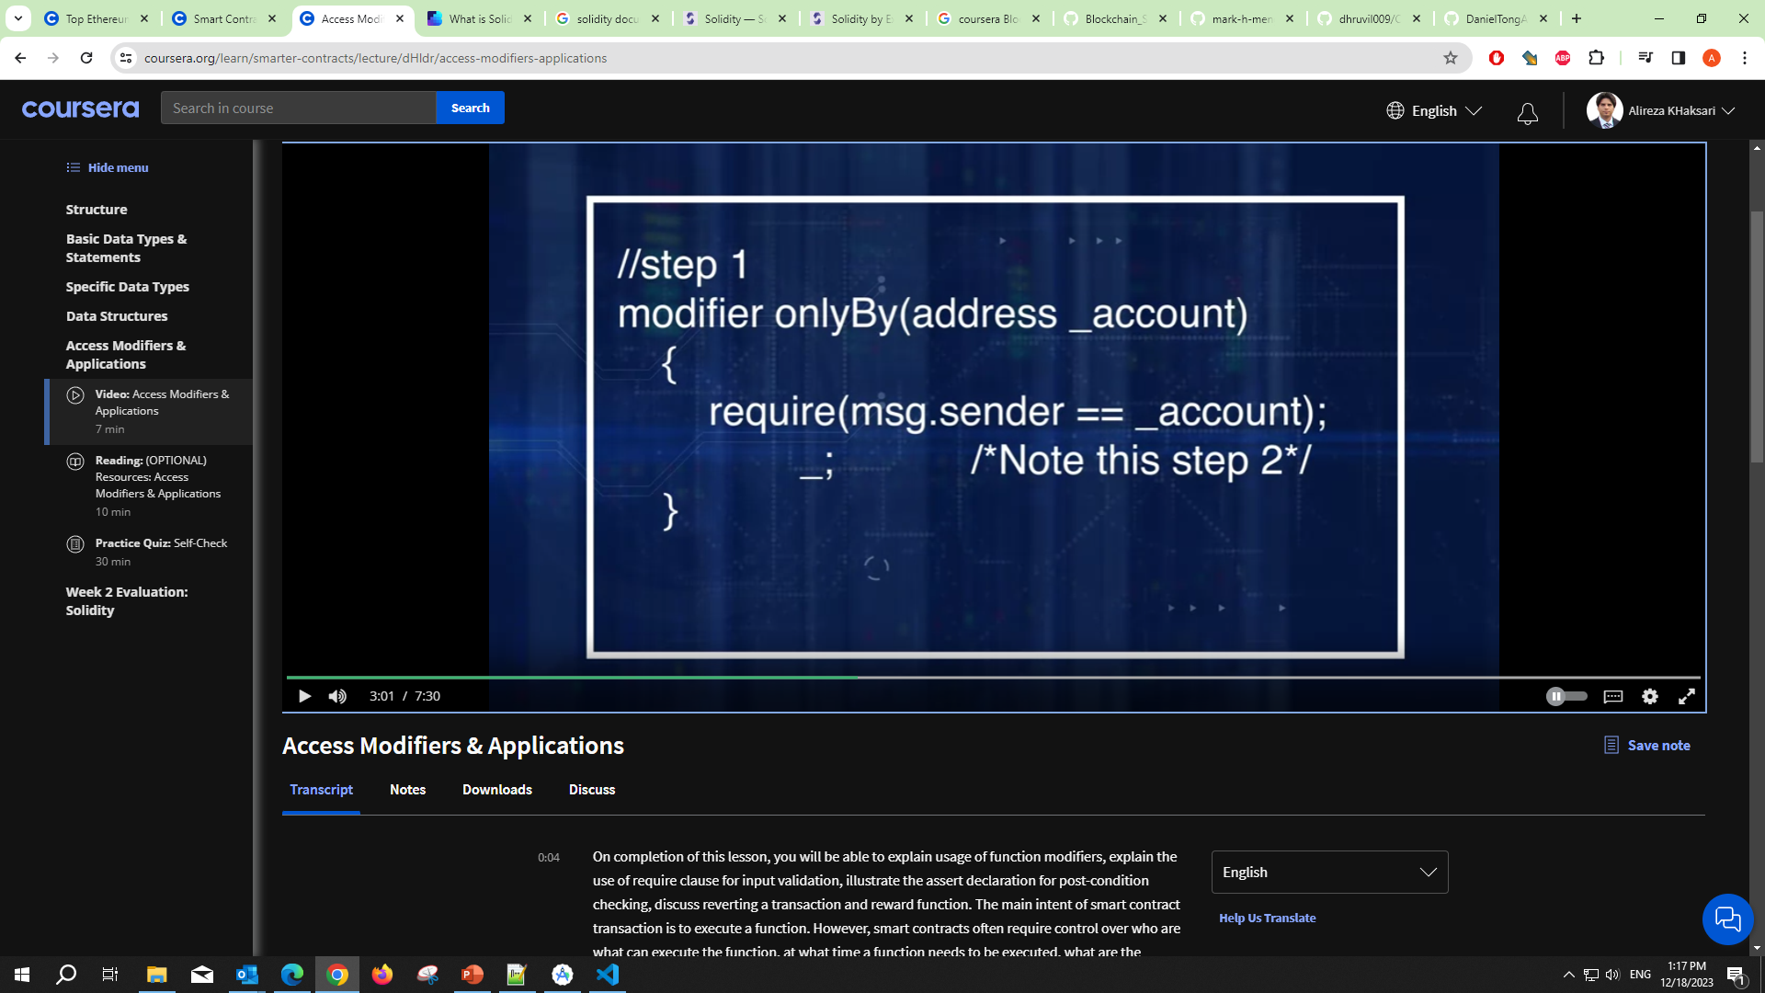
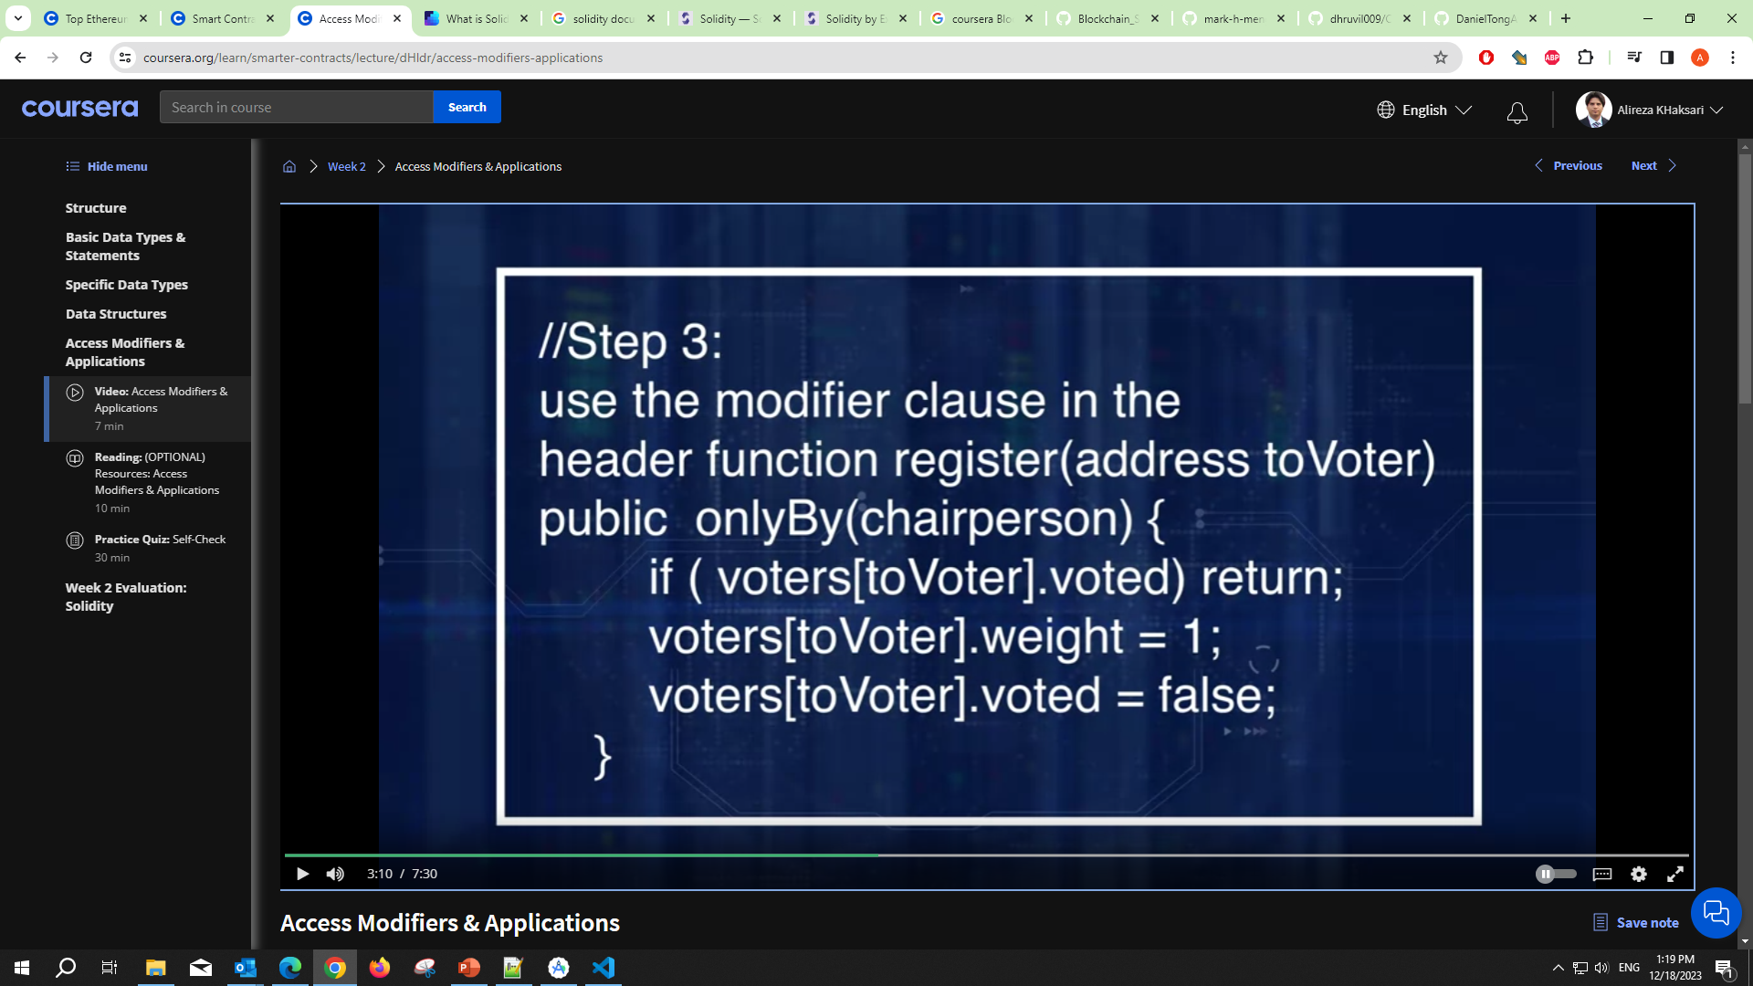
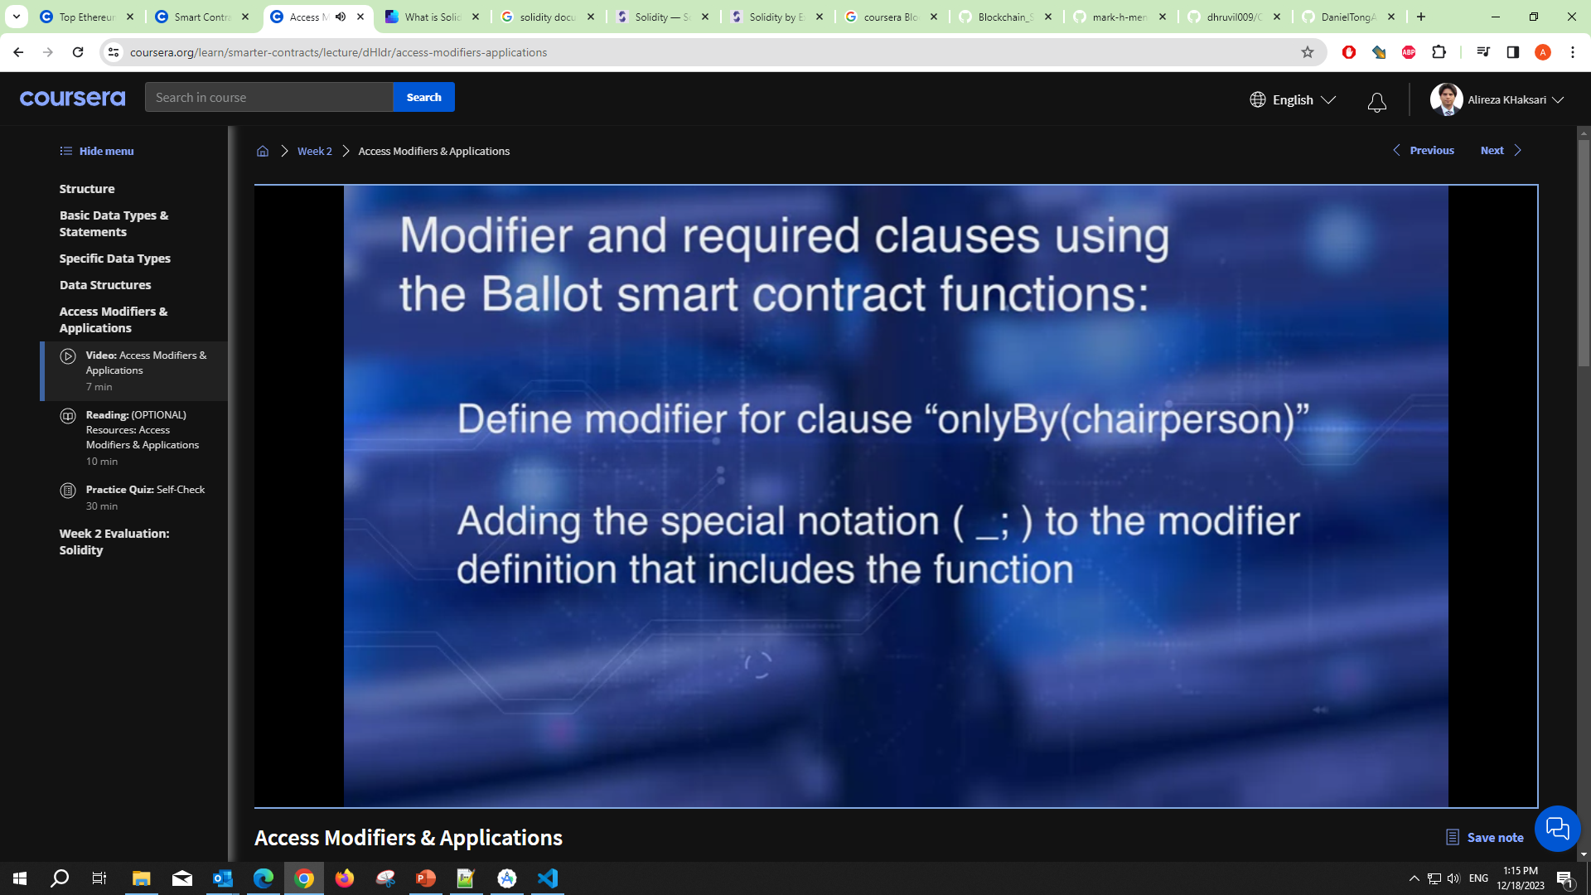
Smart Contract Week2
Step 1 is a definition of the modifier onlyBy, only the chairperson who created the smart contract valid to register any new orders.
Step 2, shows how to make the modifier include a place holder for any function.
Step 3, use the modifier clause in the header of the function definition.
Adding a special notation underscore semicolon to the modifier definition that includes the function.
Using the modifier clause in the function header.

Slide 36
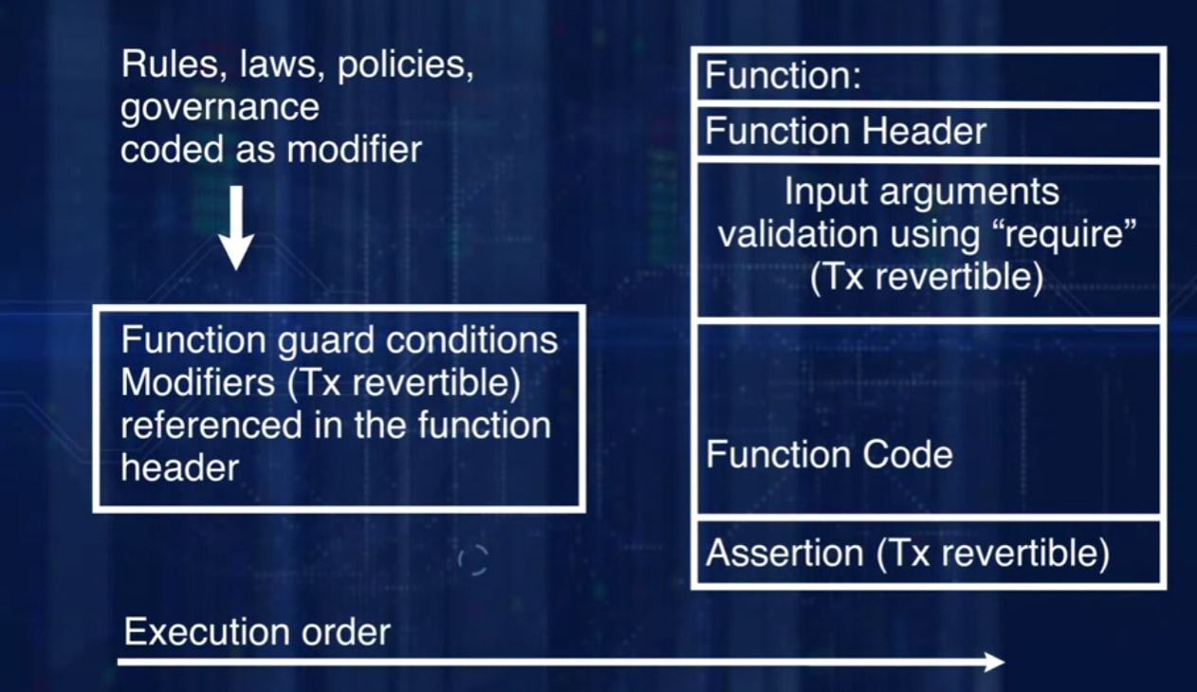
Smart Contract Week2
The picture summarizes all the features we discussed. Modifiers and error handlers, and where they are typically used. The rules, laws, policies, and governance conditions are coded as modifiers. You can use the modifiers as gatekeepers for the functions. If your transaction to invoke the function does not meet the condition specified at the header of the function, your transaction will be reverted. Will not be recorded in the block chain. Modifiers can be used to validate rules outside the function such as describing the opening of the lesson, who has access to the function, at what time, and what condition, etc. Once the screening conditions are satisfied, input validation can be carried out inside the function using require declaration statement. In this case, also the transaction will be reverted on failed validation. This is done before the execution of the function.

Slide 37
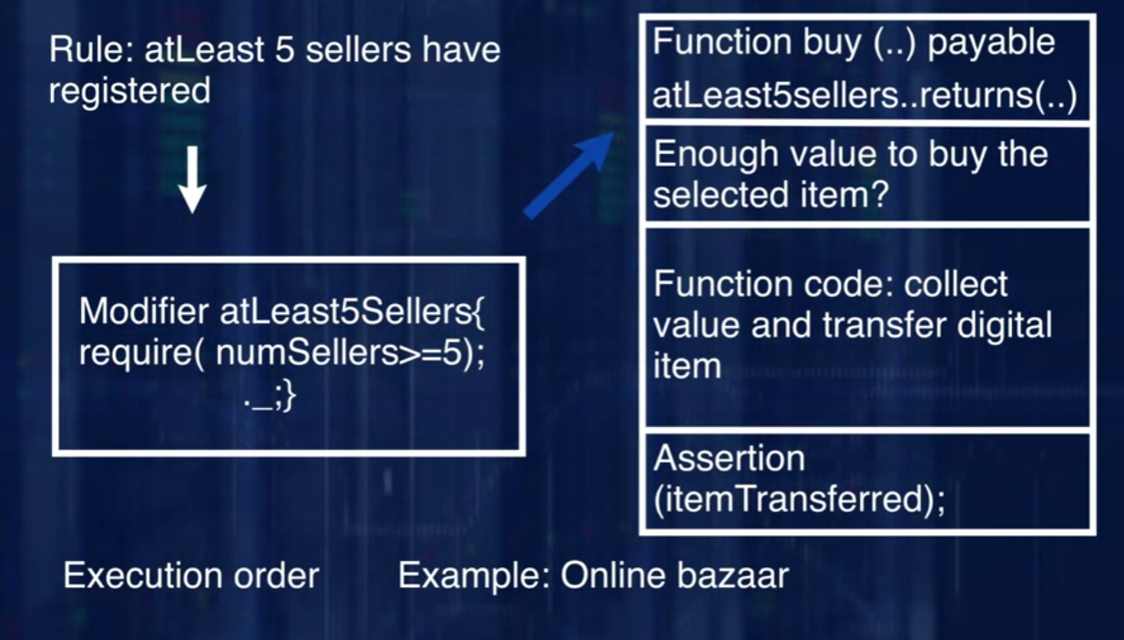
Smart Contract Week2
Here is an example of an online digital media bazaar. Input condition as specified by a modifier is atLeast5Sellers. This enforces the condition that there should be atLeast5Sellers with their products before a buyer initiates a buy message through a transaction. This is a global condition for all buyers. So, it is appropriate to install it using a modifier declarative statement. Once there are enough sellers, a buyer can buy. Inside the function, we validate if the buyer has enough money to buy the specific item requested. If not, the transaction is reverted. When the validation is satisfied, money is transferred to the seller, item is transferred to the buyer. We have a simple assert declaration at the end that the bought item should have been transferred.

Slide 38
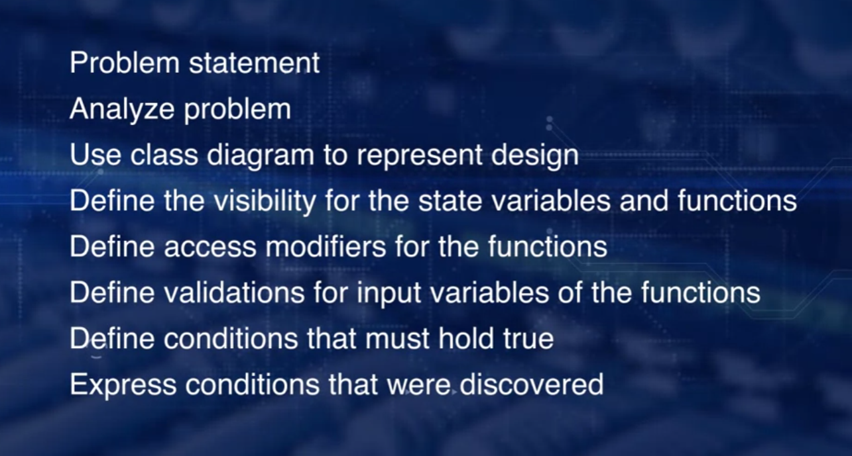
Smart Contract Week3

Slide 39
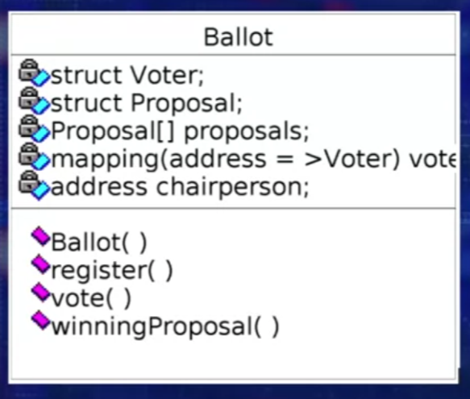
Smart Contract Week3
Here is a formal problem statement for ballot. Problem description, version one: An organization invites proposals for a project, a chairperson organizes this process. The number of proposals is specified at the time of creation of the smart contract. The chairperson registers all the voters. Voters including the chairperson vote on the proposal. To make things interesting, we've given a weight of two for the chairperson's vote and a rate of one for the regular voter. The winning proposal is determined and announced to the world. We'll exclude the delegation of voting function that is present in the current valid smart contract in solidity documentation, we will not consider this function.

Slide 40
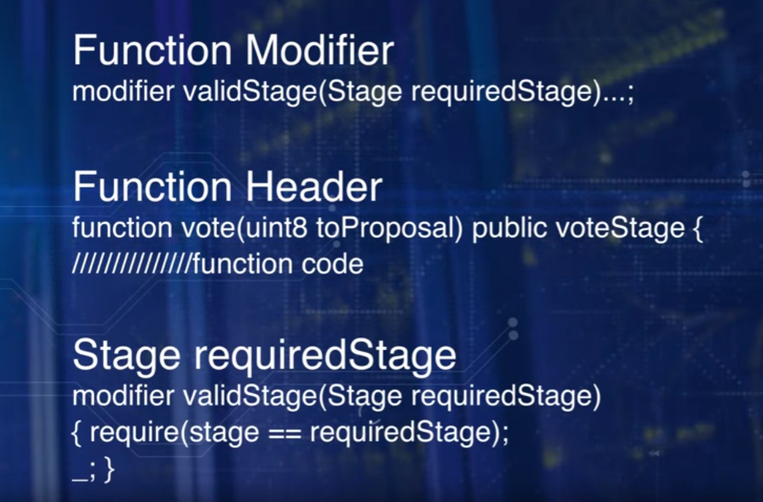
Smart Contract Week3
The learning objectives of this lesson are: explain the concept of reverting a transaction based on problem-specific validation and using a revert declaration, apply the concepts of function modifier; require; and assert.

Slide 41
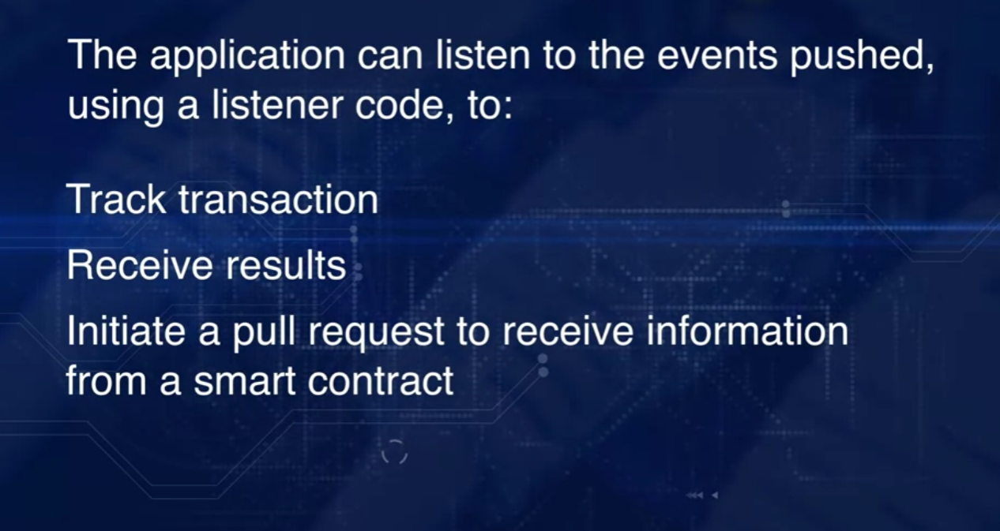
Smart Contract Week3
Client Applications
A generic format is, event, name of the event, and parameters. For example, event votingCompleted.
There are benefits to event logging. An event is pushed as opposed to regular function call that is pull to get an action performed. Typically, an event feature is to indicate to a client application, user interface or a transaction monitor that a significant milestone has been reached. The application can listen to the events pushed, using a listener code, to track transactions, to receive results through parameters of the event, initiate a pull request to receive information from the smart contract.

Slide 42
Decentralized Application (Dapp)

Slide 43
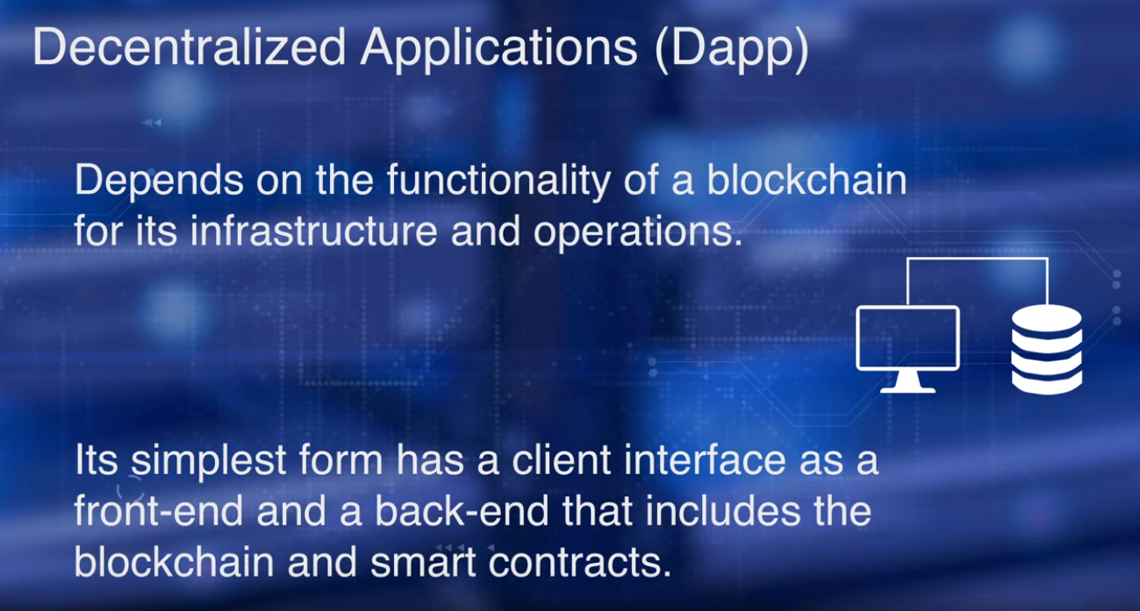
Dapp Week1: Blockchain Server

Slide 44
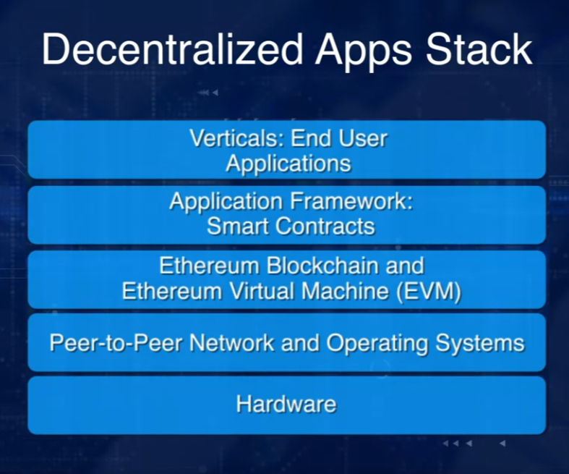
Dapp Week1: Blockchain Server
It has a peer-to-peer network on which that blockchain operates.
The node of a blockchain hosts the EVM and the smart contract runs on the EVM.
The user interfaces of the Dapp runs on top of this layer,
they use the smart contract for their logic.

Slide 45
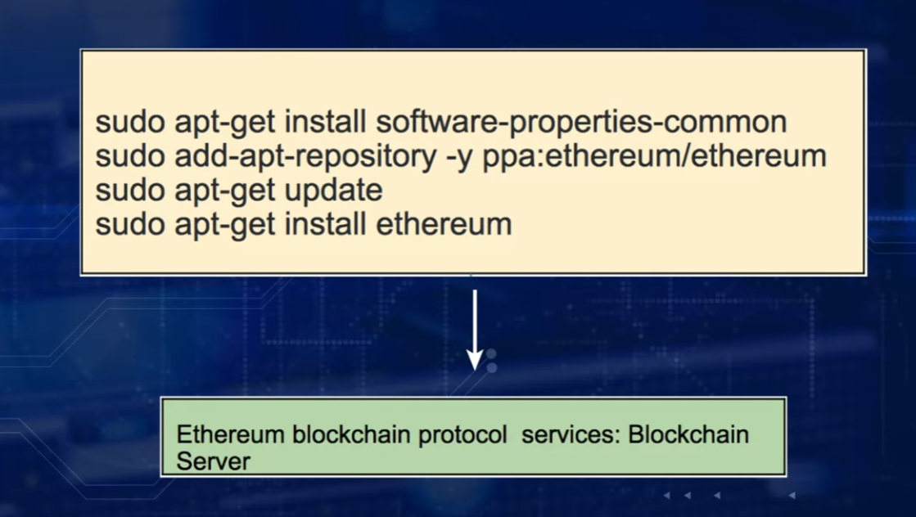
Dapp Week1: Blockchain Server
The term blockchain server also helps to differentiate the blockchain,
the ledger from the protocol services.

Slide 46
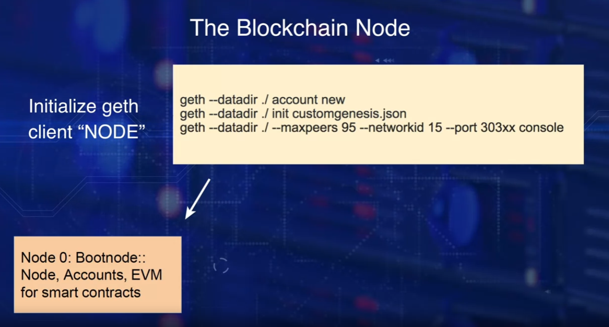
Dapp Week1: Blockchain Server
Here we create a single node, Node 0,
at the genesis node for our blockchain server.
The network ID for a blockchain server is 15 as you can observe
in the third command line, it is still a private local chain.

Slide 47
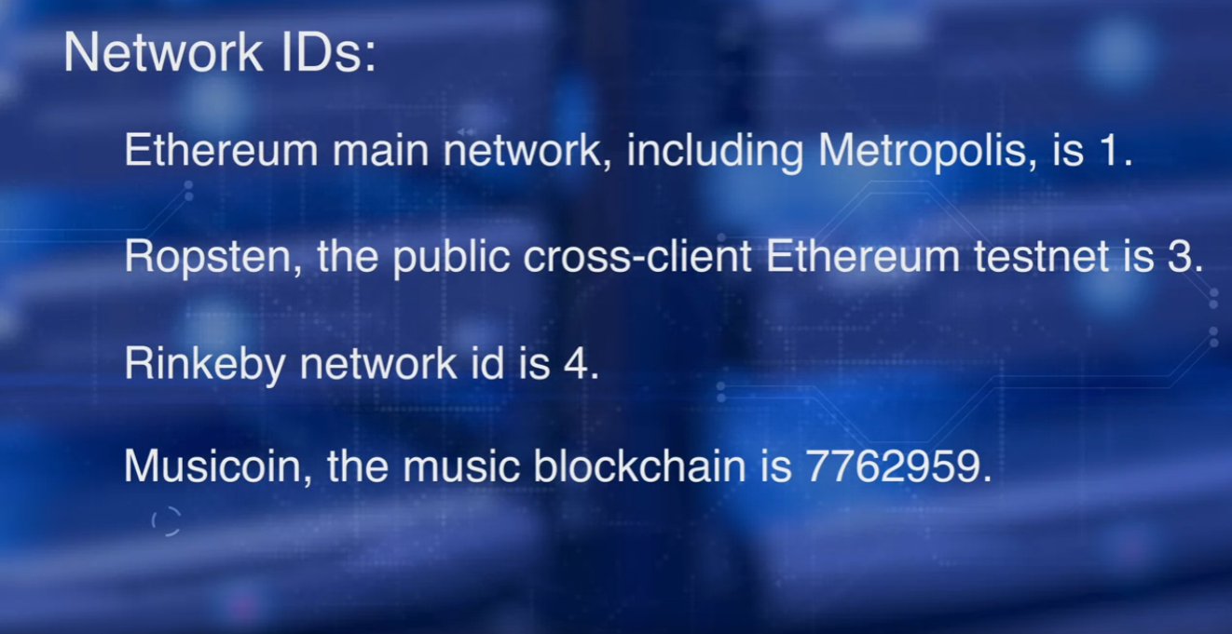
Dapp Week1: Blockchain Server
Are you curious to know the network IDs for the common public networks?
That network ID for the Ethereum main network including metropolis, is 1.
Ropsten, the public cross-client Ethereum testnet is 3, Rinkeby's network ID is 4.
There is even a Musicoin, the music blockchain,
with network ID 7762959.
When you deploy a public blockchain,
you should be aware of the network IDs of other public nets.
Also, when you're in a private environment,
you should be aware of the other network IDs in use if there are any.

Slide 48
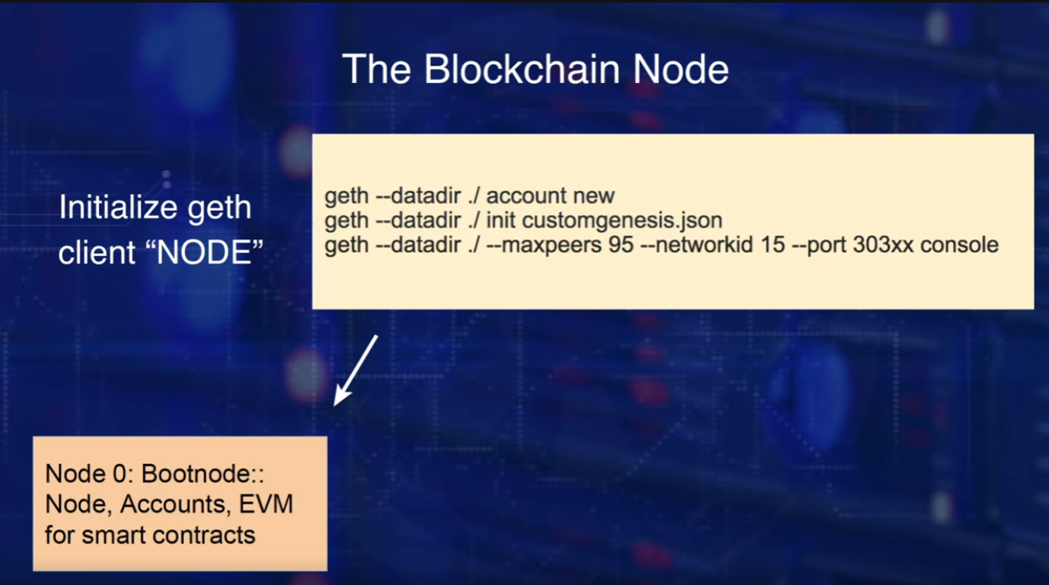
Dapp Week1: Blockchain Server
In the case shown, we are using geth command,
provided by Ethereum server recently installed.
We use geth command to install a node by creating a new account number. An externally owned account, EOA.
We then initialize the node using a custom genesis block that has a specification,
the first block of the chain.
Finally, we specify the network ID and
the port to buy into for the node that interact with the blockchain.

Slide 49
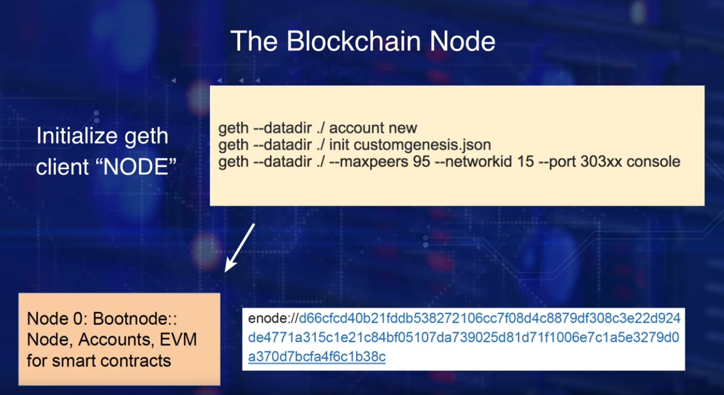
Dapp Week1: Blockchain Server
At the bottom, you will see the Ethereum node, enode address for this genesis node or the bootnode created.
Recall that a peer-to-peer network
is one of the fundamental concepts in blockchain technology.
We have not listed all the commands needed for the networking details.
That is beyond the scope of this course, the focus of which is on Dapp development.
We have completed the creation of one node,
let's now create at least one more peer node.

Slide 50
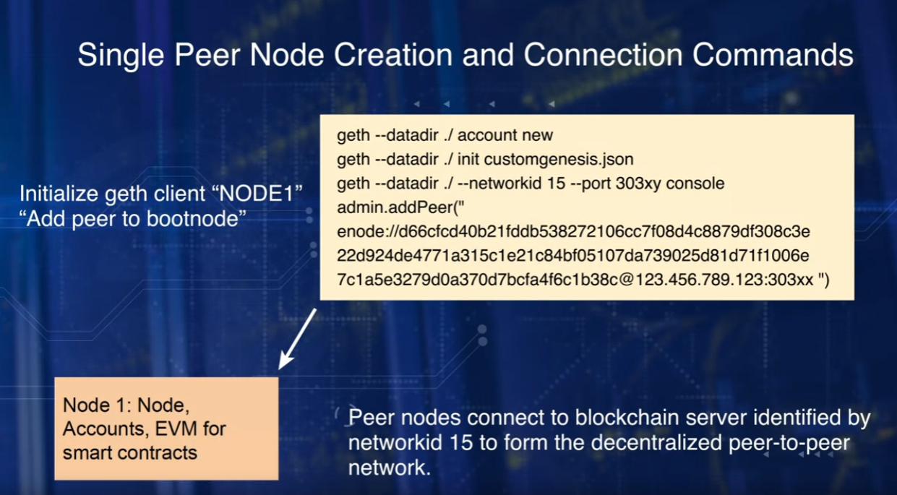
Dapp Week1: Blockchain Server
We have not listed all the commands needed for the networking details.
That is beyond the scope of this course, the focus of which is on Dapp development.
We have completed the creation of one node,
let's now create at least one more peer node.
Here we are creating node one, and
adding it as a peer node to the bootnode we created earlier.
After creation of this node, observe that we are using admin APIs, addpeer command,
the fourth command, and the enode address of the bootnode we created earlier.
The IP address and the binding port of the bootnode, 303xx,
which represents the port number of the original node 0 that we create.

Slide 51
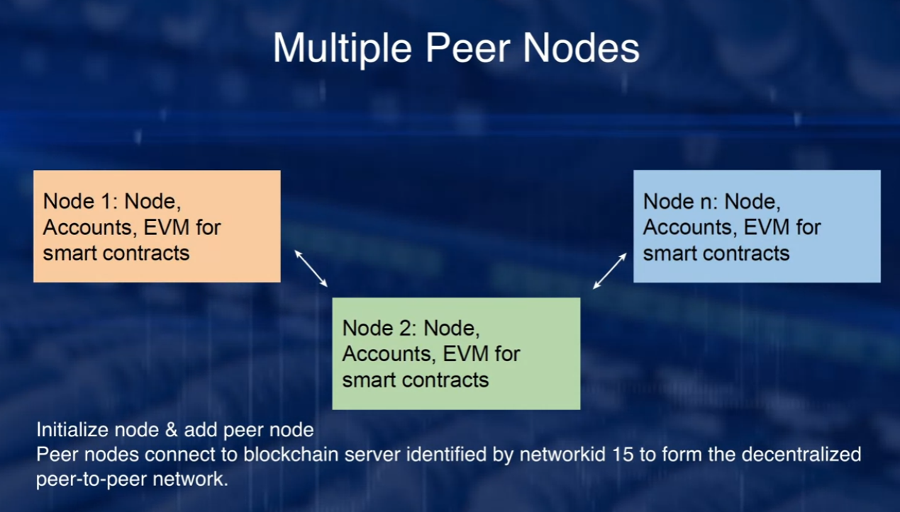
Dapp Week1: Blockchain Server
Here you see multiple peer nodes 1 to n.
When you want to join the blockchain network ID 15,
install the base Etherium server.

Slide 52
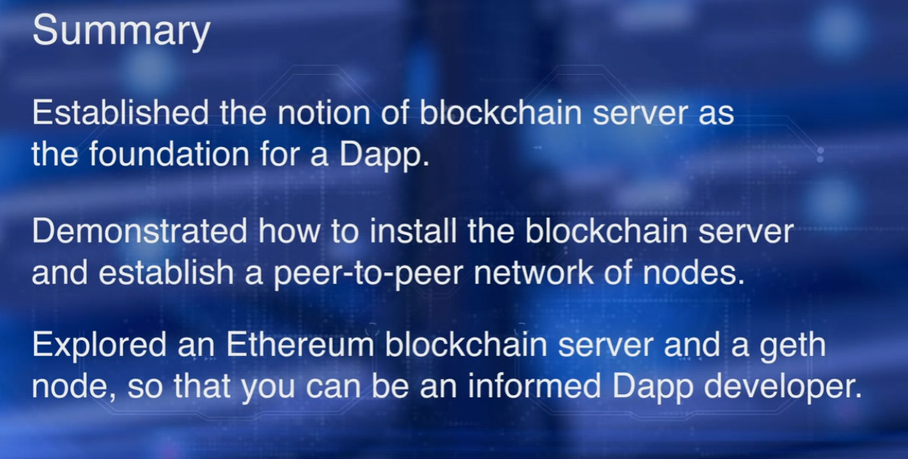
Dapp Week1: Blockchain Server

Slide 53
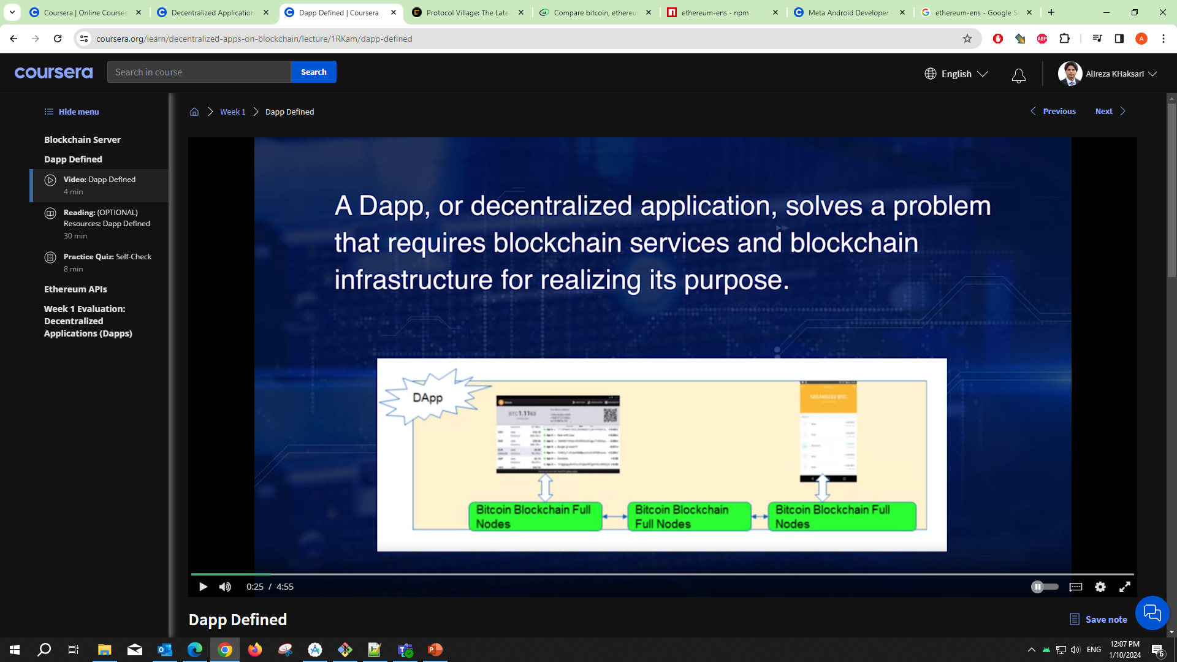
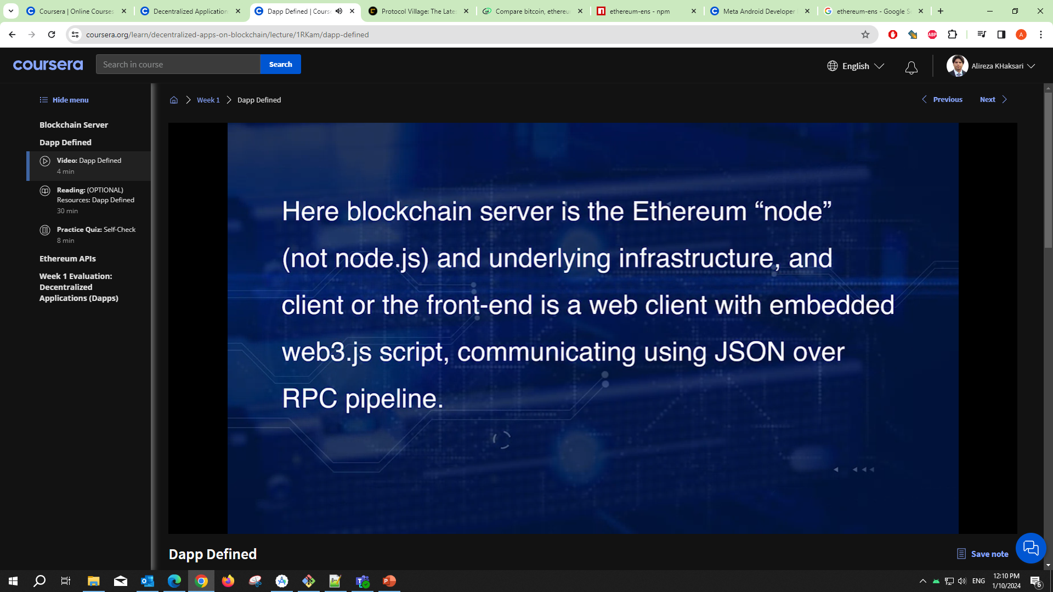
Dapp Week1: Dapp Defined
A Dapp, or decentralized application, solves a problem that requires blockchain services and blockchain infrastructure for realizing its purpose.
Typically, a Dapp has a web front-end, and
a blockchain back end, and the code connecting the two.
In such an architecture, the front-end of a Dapp channels any external stimulus from
the users to the blockchain infrastructure and returns any response back to them.
It initiates transactions to invoke functions on the smart contract.
That in turn, records the transactions and
state transition and receipts on the blockchain.
The front-end of a Dapp can be as simple as a command line interface.

Slide 54
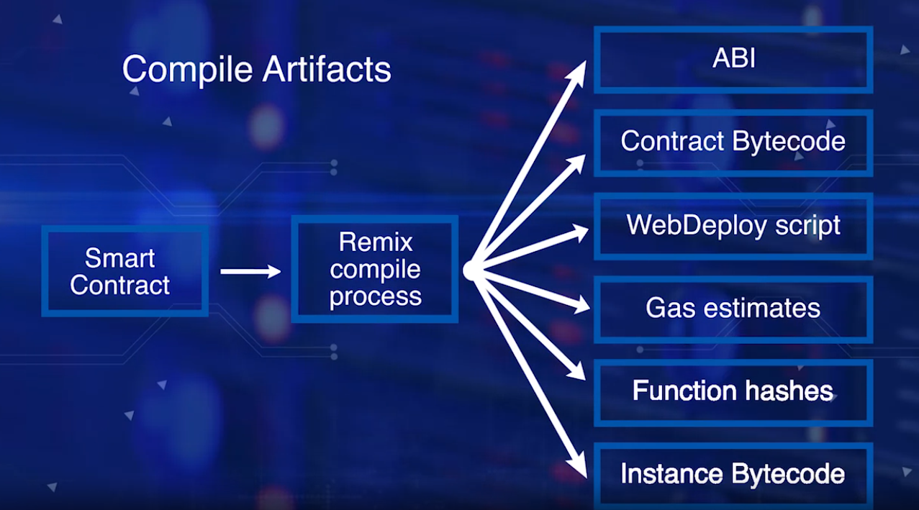
Dapp Week1: Dapp Defined
Recall from course two that web3 deploy script is an important artifact generated by the remix compile process.
If you are programmatically assembling the Dapp without the help of any development involvement, you copy the web3 deploy script into your app, say an HTML JavaScript file as a script.
Deploy the smart contract using the functions in the script.
And invoke the smart contract function using the functions in the script, and the ABI, and the smart contract address.
At this time, if you're a programmer, you can review the web3 deploy script generated in the Remix IDE.

Slide 55
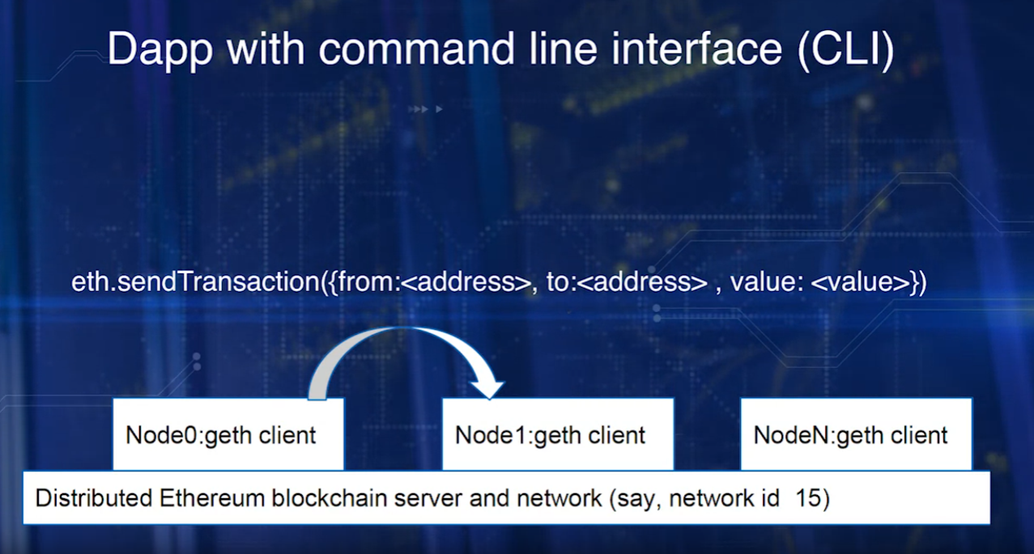
Dapp Week1: Dapp Defined
Here is a simple Dapp architecture with the nodes that we created earlier with geth command and Ethereum blockchain server and the network.
Once the nodes have been initialized with the same network, you can send transactions using the command line interface.
Also, you should be able to deploy a smart contract from the command line.

Slide 56
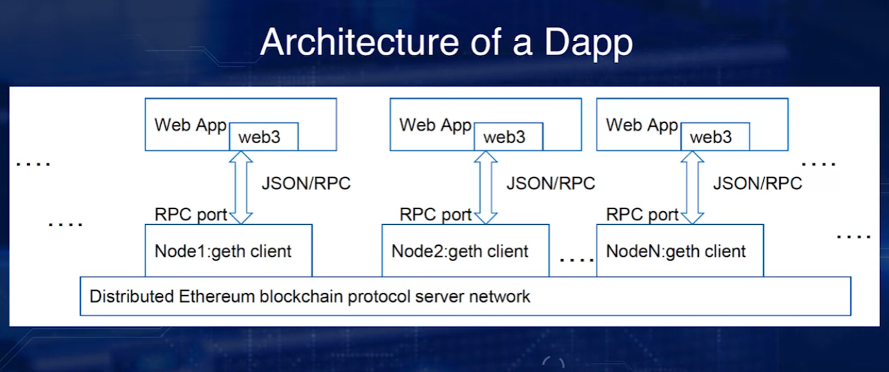
Dapp Week1: Dapp Defined
we will use a simple but intuitive web interface as the front-end to the blockchain Dapp we are planning to develop.
There are multiple full nodes, with only three of them, Node1, Node2, NodeN, shown.
Geth command is used to expose RPC port 8544 using the commands geth--rpc--rpcport 8544.
From the web client, the functions including smart contract deploy and invoke functions are facilitated through web3.js module.

Slide 57
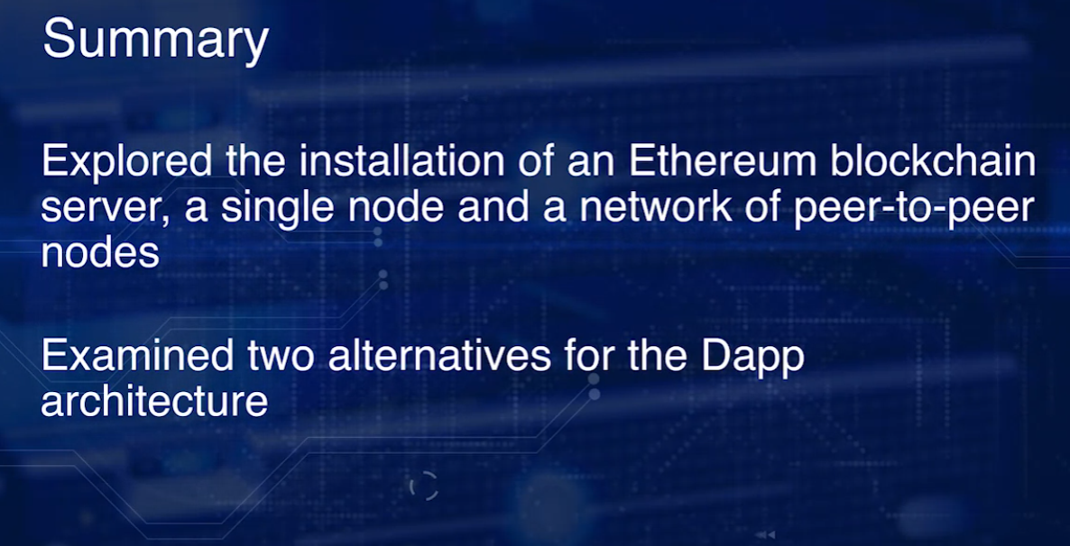
Dapp Week1: Dapp Defined
To summarize, we explored the installation of an Ethereum blockchain server, a single node, and a network of peer to peer nodes.
We also examined two alternatives for the Dapp architecture.
One with command line client and the other with a web client.
In the next lesson, we'll explore some support APIs for developing a Dapp.

Slide 58
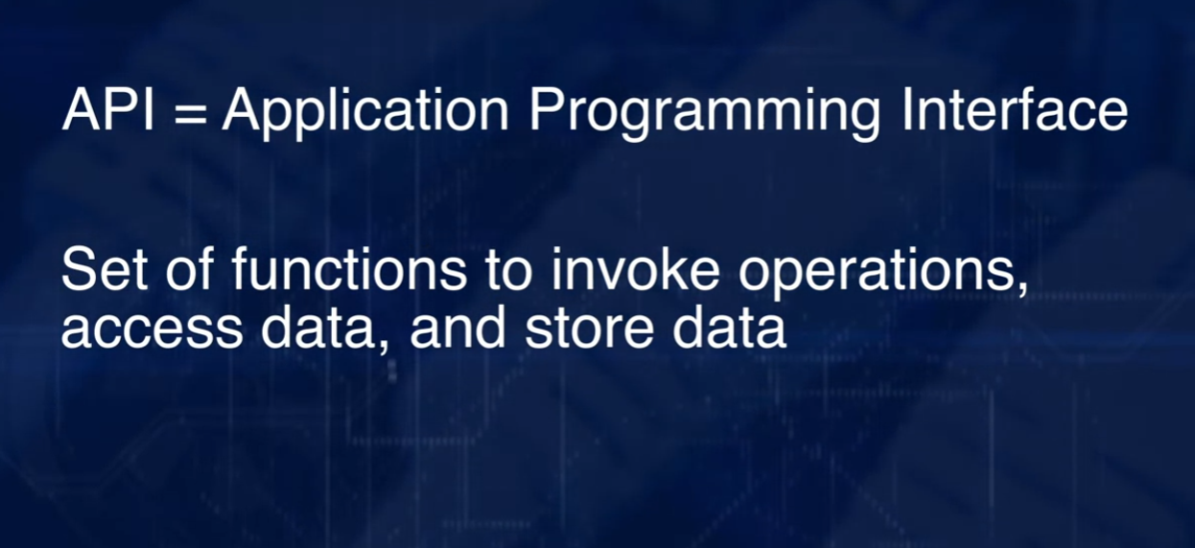
Dapp Week1: Etherium API
What is an API?
API, or Application Programming Interface, is a convenient and standard way to expose a set of functions related to a specific dataset and services.
APIs also lend to reusability of code.
An API publishes a set of functions or methods that can be
used programmatically to invoke operations, access data, and store data.
Access to an API can be controlled by specific access method,
for example, public keys, if so warranted by the application.
Blockchain server and node provide the blockchain functionality and data structures.
How do applications call the functions of a blockchain, invoke them?
How do they use them for accomplishing tasks of an application?

Slide 59

Dapp Week1: Etherium API
For example, in the command miner.start(),
miner is API, and start() is the function of the miner API.
Why in the context of a Dapp I'll be learning about APIs?

Slide 60

Dapp Week1: Etherium API
There are two major categories of APIs.
The first one is the management APIs, that includes admin,
debug, miner, personal, and txpool.
They support methods for management of the geth node.
The second one is the web3 API, web3, eth, and net.
They support methods for development of Dapps.

Slide 61



Dapp Week1: Etherium API
Admin, the Admin API allows you to use functions to work with your Geth instance, including network peer and the RPC endpoint management.
Examples, admin.addPeer(), admin.nodeInfo().
In this case, admin is the API, and addPeer and nodeInfo are functions of the admin API. You can observe that admin supports functions for management of the node.
Debug API, example, Debug.dumpBlock(16).
This will display the block header details of block 16.
You can observe that the debug API provides you the ability to peek into the blockchain, study it, and debug any issues by looking at the block.
Miner API, the miner API allows you to control
the nodes mining operation and set various mining specific settings.
Example, miner.start(), miner.stop() are sample functions that will start and stop the miner.
You can also say miner.start(6), where 6 parallel threads are assigned to the mining operation.

Slide 62

Dapp Week1: Etherium API
Personal API deals with the creation and management of accounts within a node.
It also manages private keys in the key store, that's why it is called personal API.
Example, personal.newAccount() will create a new account within a node.
Txpool API, the Txpool, or transaction pool API, gives you access to several non-standard RPC methods to inspect the contents of the transaction pool, containing all the currently pending transaction, as well as those queued for future processing.
Example, txpool.inspect() lists you all the pending transactions for you to peruse and collect for building a block of transactions.

Slide 63


Dapp Week1: Etherium API
Web3.js library, when included into Dapp, lets you use web3 object provided by the web3.js library and all its objects.
It also lets you communicate with a local node through the RPC port.
It also provides access to the eth object and its function via web3. , and net object via web3.net, and their respective function. You can also access other management APIs to the web3 object.
There is also Whisper API, web3.ssh.
It is used for secure gossiping and enables the Whisper protocol.
Web3 is a JavaScript library that's specifically designed for
use with web client or Ethereum Dapps.
It's a portal through which all the underlying operations of the Ethereum
node on the blockchain server can be invoked.
For example, a Smart Contract deployment and Smart Contract function invocation.

Slide 64

Dapp Week1: Etherium API
Now that we know the APIs, here is a simple architecture of a Dapp.
It comprises multiple full nodes with only three of them, Node 1, 2, and N.
You can also see all of the APIs discussed.
Geth command is used to expose the RPC port, as well as the APIs.

Slide 65

Dapp Week1: Etherium API
For a Dapp, the geth client has to expose an RPC endpoint using RPC port command.
A web3 object is instantiated in the web page script.
Recall that web3.js is a JavaScript library.
Requests or calls are invoked on the web3 object.
Requests are transmitted as a JSON or RPC pipeline between the web client and
the geth client.
Requested call and function is executed using appropriate API and
Smart Contract code.
And the result, return to the back client.

Slide 66

Dapp Week1: Etherium API
We created a two node peer-to-peer blockchain network with ID 15.
We learned the foundational knowledge required to be a developer of a Dapp and
a blockchain citizen.
We explored the Dapp architecture and the supporting APIs.
Armed with all this knowledge, we are ready to develop our first Dapp.

Slide 67

Dapp Week2: Truffle Development

Slide 68

Dapp Week2: Truffle Development
To maintain the focus solely on the process of Dapp development we'll not handle the time elements or stages of the balloting.
At this time we'll talk about the four steps that make up the design process.
We'll represent the main logic of the problem using the smart contract and solidity.

Slide 69

Dapp Week2: Truffle Development
We'll begin with data and operations.
To this we'll add modifiers and validation checks
to make sure rules specified in the problem definition are addressed.
We'll design a test smart contract that will ensure all the stated requirements are met. This like unit testing.
After the successful completion of unit testing we'll
add the front-end component and test the completed Dapp. This is like integration testing.

Slide 70

Dapp Week2: Truffle Development
Applying the general design process just discuss to the ballot App requires five steps.
Step one, we'll design the ballot dot sol.
Step two, we'll then illustrate the modifiers with just one modifier, only owner referring to the qualified person as the chairperson.
Recall that in the design of a smart contract you can
use modifiers to represent global rules.
Step three, we'll add a tester code for the required problem specification and run the test to make sure they all pass.
Step four, we'll add the user interface component.
And step five, we'll test the complete application by interacting with the interface.

Slide 71

Dapp Week2: Truffle Development
Here is a family of ballot smart contract design.
Please note the addition of a compartment for modifiers.
This compartment is indeed very important.
Smart contract design now has four components.
The smart contract name, data, modifiers, and functions.
Recall that modifiers represent the common rules and policies and constraints.

Slide 72

Dapp Week2: Truffle Development
Truffle is an integrated development environment or IDE that provides a range of features for Dapp development including commands for initializing
a template or base directory structure for a Dapp, truffle in it.
Smart contract compilation, truffle compile.
Local test blockchain for testing with a console, truffle develop.
Migration scripts for deploying the smart contract, truffle migrate.
A test environment for testing the deployed contract, truffle test.

Slide 73

Dapp Week2: Test Driven Dev
Testing with ballot smart contract can be done by positive tests, making sure for a given valid input, it performs as expected.
We'll test the complete ballot cycle of deploy,
register, vote, winning proposal.
And negative test, making sure it handles invalid inputs and situations appropriately.

Slide 74

Dapp Week2: Web Interface & Testing
copy Ballot2.zip into your workspace.
Unzip the Ballot2.zip.
Note the directory structure that appears.

Slide 75

Dapp Week2: Web Interface & Testing
contracts has solidity contracts.
Migration folder has migration scripts.
Test has the test scripts.
Build has the JSON artifacts generated by the compile process.
Source folder has the web assets, such as JavaScript, CSS, and index HTML.
Node module folder has the node.js modules.
And JSON files and JavaScript are the configuration files.

Slide 76

Dapp Week2: Web Interface & Testing
There is an file called app.js in the source Java's directory.
This instantiates the objects needed for the web client to communicate with the blockchain node.
We need to expose the blockchain accounts created
through web3 provider object of the app.
Simply put, web3 init code does that.
It shows how web3 object is created and linked to the test chain we've applied.

Slide 77

Dapp Week2: Web Interface & Testing
Secondly, we need to tell the web3 where to find the smart contract artifacts.
Init contract method of the app.js does this.
Then, you'll have to add methods to handle the calls to the smart contract, and
return values from the smart contract to the web interface.

Slide 78

Dapp Week2: Web Interface & Testing
Now you're ready to go through the development process once again.
Restart the test chain.

Slide 79

Dapp Week3: Design improvements
Recall blockchain is not a data repository.
Number two, is there a way to log the events happening on the chain?
Either forgetting a notification of completion of
an operation or if something needs attention.
Number three, smart contracts cannot access the outside links, C, to get today's US prime interest rate.
Is there a provision to get outside information that will still keep the blockchain consistent?
US daily interest rates are the same or lower for
a given date as long as you normalize the day to epoch time.

Slide 80

Dapp Week3: Design improvements
On completion of this module,
you will be able to list additional features of
solidity that make a smart contract efficient, practical, and useful.
Reuse code and apply hierarchical structuring of
a smart contract for specialization and generalization.
Illustrate the use of events and pushing events to subscribing applications.
Explain the use of smart contract named using oracles.

Slide 81

Dapp Week3: Design improvements
For minimizing the footprint on the blockchain,
let's consider storage versus memory attributes of data.
By default, all the state changes did variables define in the smart contract, are saved as state on the blockchain. Recall from, course one, that the state hash of the ethereum block header, is computed using Merkle tree or Patricia Merkle tree of the state variables.
We would like only a sliver of data that is needed as state for provenance, governance, and immutability to be saved on the blockchain.
So, our goal is to minimize the state or the footprint of the Smart Contract and lower the gas costs.
One of the ways you can accomplish this, is by correctly using memory and storage keywords.

Slide 82

Dapp Week3: Design improvements
Memory is transient memory in RAM and storage refers
to persistent store in the permanent storage device like your hard drive.
Memory is temporary and is a race between function calls.
Memory is a byte array. It's cheaper to use an Ethereum. Since everything cause gas points, we have to be aware of this.
Every contract is assigned a storage space and this storage is permanent.
The values in it persists between function calls.
Storage is a key value store of 32 bytes each for the key and the value.
All storage data is considered a state and used in
the computation of state hash route of the header.
Using a memory location, cause few guess points, 1-3, whereas storage costs in the order of thousands of points.
Twenty thousand points to set up, 5,000 points to change a value and so on.
Understand, that a smart contract is global and a copy of it is present in every full node. The state footprint hash is present in every block. We don't want unnecessary details on the immutable ledger.

Slide 83


Dapp Week3: Design improvements
There are many ways we could manage the memory versus storage trade-off.
Here we'll consider only the composite data struct and arrays.
In a solidity smart contract, struct and array are by default assigned storage instead of memory, even when they are local to functions.
While a struct or array is used as a parameter or a local variable in a function, declare them as memory variables.
If the memory attribute were not there, temporary variable investors would have been a storage variable wasting state variable space.
In the development of a smart contract in solidity language,
consider using memory variables for any transient data.
Use storage variable only for something that needs to be persisted on the blockchain.

Slide 84
Dapp Week3: Design improvements (Kill or Del SC)
Consider this scenario, in the US, 2016 income tax laws are invalid.
So, are the smart contracts we might have deployed for this.
Thus the smart contracts are now useless.
What happens to the money tax that any of the smart contracts would have collected?
Can we change the ownership of these smart contracts to a trustee account,
as we deploy smart contracts for representing the new tax laws?

Slide 85

Dapp Week3: Design improvements (Kill or Del SC)
Recall that a smart contract is identified by an address.
This is an important concept.
It may represent a token, an organization, a person, human or otherwise and the related logic rules and operations.
A smart contract has a owner. By default, it is the creator of the smart contract.
It has a value or ether balance. Its ownership may change or it may have to be deleted. Given all these complex attribute, how do you manage a smart contract? To delete or kill a smart contract, Solidity provides a function called self-destruct.

Slide 86

Dapp Week3: Design improvements (Kill or Del SC)
To delete or kill a smart contract, Solidity provides a function called self-destruct.
Understand this call is irreversible as per the default blockchain protocol.
Once killed, the smart contract cannot be revived or accessed.
Another the good programming practice is to make sure only the owner or the owners of the smart contract or an authorized person has permission to self-destruct a contract.

Slide 87

Dapp Week3: Design improvements (Kill or Del SC)
Another the good programming practice is to make sure only the owner or the owners of the smart contract or an authorized person has permission to self-destruct a contract.
Assume, a time duration is also specified for the contract.
Modifiers are used to enforce the destructors address and the time duration for this smart contract.
Here is the code.
What happens when a kill function is executed.
The smart contract code is removed from the state of the blockchain, if the conditions specified by the modifier are satisfied.

Slide 88

Dapp Week3: Design improvements (Kill or Del SC)
Recall that smart contract may represent an asset or a business.
During the lifetime of an asset, ownership may change.
It may change due to the sale of an asset, donation of an asset or by bequeathment.
These are just a few.
There are many more scenarios for ownership transfer.
This function can implement a transfer of ownership, but make sure you qualify the transfer with a modifier or modifiers so appropriate rules are enforced from managing ownership and lifetime.

Slide 89

Dapp Week3: Design improvements (Kill or Del SC)
It is possible a complex application could be composed of many smart contracts, one instantiating the other or inheriting others.
It is also possible that the symbols or namespace for an organization is
defined in a common smart contract that needs to be applied.
For example, federal laws referred to here as Fedlaws,
can be a legal framework that can very well represent an interface smart contract, letting the state and the field offices implement them,
as they see fit.
In this case, StateLaws and FieldLaws are also smart contracts and they are associated using the import statements.
This is inheritance at work.

Slide 90

Dapp Week3: Design improvements (Kill or Del SC)
As a subtopic of relationship among smart contract,
it is possible to create libraries and import existing libraries into your Solidity smart contract code.
Libraries are special smart contract with no ether balance, no payable functions and no state to be stored in the block chain.
A fine example is a SafeMath.sol by Zeppelin, that can be included in your smart contract for any math computation.

Slide 91


Dapp Week3: Event
Events are useful for pushing notification to indicate completion of a smart contract operation, say the execution of a transfer.
Events can be used to notify any event occurrence within a smart contract and the blockchain.
Events are useful for logging activities of a smart contract. In this role, event logging is like your printf or console log. Logs can be reviewed to audit the functioning of a smart contract.
Event enables asynchronous operations between an event sender and the receiver.
Event framework is an efficient alternative for polling to check if a request has been completed.

Slide 92

Dapp Week3: Event
For example, in the coin.sol, you will see event sent with parameters from, to and amount.
You invoke an event by its name and actual parameter values.
This will push or log an event occurrence for its listeners.
How do you consume an event?
You setup the listener for an event or events, and consume or catch an event notification, and act upon it.

Slide 93

Dapp Week3: Oraclise
Recall that smart contract operates in a sandbox. It cannot call outside function or link to an external resource.
So how do you get access to an external resource?
By using a special smart contract called using oraclize.
Why can't a smart contract access outside sources?
The results of an operation on the blockchain has to be deterministic.
These conditions limit the applicability of the smart contracts in many
real world applications that may involve obtaining facts,
data, and assets from external world sources.
Moreover, the data has to be obtained at the time of execution and
may not be available at the time of deployment of the contract.
The oraclize concept addresses this problem of fetching external data from a smart contract.
What is oraclize?
When you look up the meaning of oracle, Merriam-Webster's definition of oracle is, an authoritative or wise expression or answer. This definition very closely defines the rule of oraclized service in the smart contract dApp development.
Oraclize is described as a data carrier between the web resources,
APIs and the URLs, and the smart contract.
Of course, oraclize is outside the blockchain protocol.

Slide 94

Dapp Week3: Oraclise
UsingOraclize is a smart contract that provides minimally a query function to access external sources.
It not only fetches the data, but it also provides proofs and authentication about the sources if needed by calling the smart contract.
The data requested is returned through a callback function since accessing the data and verification may take some time.

Slide 95


Dapp Week3: Oraclise
We do not want the blockchain smart contract waiting on results.
The following is a simple class diagram relating the smart contract,
usingOraclize and an external data source.
With the smart contract, average winter temperature is deployed.
It calls fetchData function. That in turn in-walks oraclize_query with the URL for the data source.
Since it may take time to fetch the data, a call back function is provided so that it can invoked when the required data has been fetched.
UsingOraclize accesses the external data source, authenticates and
sends the data with the proof to the originating smart contract.
In this case, AverageWinter Temperature.

Slide 96

Dapp Week3: Oraclise
First you import usingOraclize smart contract using the import statement.
Then the contract AverageWinter Temperature inherits from usingOraclize.
Contract AverageWinter Temperature is usingOraclize.
Here, AverageWinter Temperature is inheriting usingOraclize and
using its function to access external resources.
Additionally, you may also have methods to verify the proof and authenticity of the data fetched.

Slide 97

Dapp Week3: Oraclise
Summary

Slide 98

Dapp Week4: Application Models & Standards
Objetive

Slide 99

Dapp Week4: Application Models & Standards
We are going to start this lesson on Dapp model with a hierarchy diagram that gives a high level view of Various Dapp model, starting from the genesis of Bitcoin.
After this lesson, you will be able to list some important models of Dapp
and explain the evolution of Dapp models from cryptocurrencies to cryptoassets.
Every Bitcoin was minted by the protocol, except for the genesis transaction from Satoshi to Hal Finney.
Then came the innovation of Etherium Smart Contract.
It helped automate the crowd funding for startups using a virtual instrument called Koine and the process of initial coin offering. This is similar to an initial public offering IPO of company stocks.
Coin ICO use a block chain to record the distribution of the coin, receive funds, specified rules,
and to enforce any preconditions and policies.

Slide 100
Dapp Week4: Application Models & Standards
In the Dapp hierarchy,
we have included only as coined Dapps, Ethereum, and Zcash. However, there are hundreds of ICOs and coin offerings. It has become a popular mode for crowdfunding. Did you know the Zcash focuses heavily on privacy and uses closed-code?
he next Dapp we will look at is Tokens and initial token offering.
Sometimes tokens and coins are used synonymously. However, we distinguish between these in our model. Token is like a Dapp coin but, its offering is typically associated with an asset or utility.
For example, in the highly popular cryptoKitties, a token is used to represent the kitty or all the rules for the creation lifecycle, breeding etc are written into the immutable Ethereum block chains Smart Contract.
At pre-determined times, a certain number of new tokens are
released and auctioned off for raising new funds. Assets are Kittys in this case,
also appreciate or depreciate in price based on the demand. So the tokens are non-fungible. In other words, value for Tokens can change during its lifetime.

Slide 101
Dapp Week4: Application Models & Standards
Turn your attention to DAO,
a Decentralized Autonomous Organization is an early innovation in Dapp.
DAO was an investment instrument deployed as a smart contract on Ethereum block chain.
Autonomous venture capital Dapp to be exact.
The idea was to showcase an autonomous organization without traditional corporate governance structure for a decentralized anonymous Fund-Raising, and automatic investing.

Slide 102
Dapp Week4: Application Models & Standards
Decentralized Marketplace
FinTech, short for financial technology, has great potential for innovator Dapps.
This domain ranges from decentralized investment instrument
to micropayment channels.
Currently, a significant issue for FinTech Dapps is the high
confirmation times of the transactions compared to the centralized technologies.
At the time of this recording, Dapps cannot meet the sub-second trade
confirmation times that the centralized systems can deliver for stock trading.
In this case, scalability is a dominant issue.
Privacy is another issue to be considered in this context. Regulation and policies of the US Securities and Exchange Commission, SEC, and the counterpart organization in many countries, have an effect on the FinTech Dapps and their development.
Security, privacy, safety, and fraud prevention are major issues.
In fact, tokens, coins, and ICO Dapps provide a backdoor entry for
many investors and financial institution into the cryptocurrency markets.

Slide 103

Dapp Week4: Application Models & Standards
Portable Operating System Interface or POSIX standards were introduced for interoperability among different operating systems.
IETF, the Internet Engineering Task Force, was established for defining the Internet standards through the Request for Comments, RFCs.
Standards bring order, safety, and many more qualitative attributes to the field. Standards can bring regulation and clarity.
Explain importance of ERC20 and ERC721 tokens.

Slide 104

Dapp Week4: Application Models & Standards
EIP is an approach to process improvement in Ethereum ecosystem.
EIP or Ethereum Improvement Proposal is a means to manage the protocol specification, improvements, updates, client APIs and contract standards.
EIP handles issues at four different categories including; core, or core Ethereum protocol, network, or network level improvement, interface,
or interfaces such as ABI and RPC, and ERC, or application-level conventions and standards.
ERC is Ethereum Request for Comments, like RFCs of the Internet.
ERC proposal for application-level issues are given a proposal ID, thus, become ERCN. Example, ERC20, ERC721, et cetera.

Slide 105

Dapp Week4: Application Models & Standards
The solution draft is proposed by the ERC document and discussed in the community.
The ERCs are available on the GitHub and discussed on the guitar and subreddits.
The result could be accepted, rejected, withdrawn or deferred.
An accepted ERC is finalized and is allocated an EIP number and implemented by the protocol.

Slide 106

Dapp Week4: Application Models & Standards
You experienced how easy it is to issue a coin on your own and transact.
You can name your coins something fancy, and deploy it on the Ethereum main chain and issue this digital currency to the whole decentralized world to buy.
Anybody with an internet connection can connect and transact using your coin.
Given this context, let's consider the issues.
What does a token represent?
What is the value of this token?
What can I do with it?
Is it an investment, or utility token?
Can I exchange it for another type of token?
Can I exchange it for any fiat currency?
Is it fungible, or non-fungible?
Do you remember non-fungible?
Are the tokens limited in number? And many more.

Slide 107

Dapp Week4: Application Models & Standards
These, and many issues are addressed in the standard ERC20 and ERC721.
ERC20 is specified as a smart contract interface.
It specify a set of rules that allow token DApps to interact with each other to be exchanged with each other, and transact on Ethereum network.
The interface looks like this.
Given this interface, how do you make a token ERC20 compliant?
Of course, you have to implement the functions required by ERC interface.
Recall our discussion of interface in the last module.
Augur REP, rep we discussed earlier is a ERC20 token.

Slide 108

Dapp Week4: Application Models & Standards
ERC 20 is a fungible token.
Dictionary definition of fungible says, able to replace or be replaced by another identical item, mutually interchangeable.
One ordinary US dollar bill is equal in value
to any other ordinary US dollar bill.
One bitcoin is equal in value to any other bitcoin.
One ether is equal to any other ether.
Value of this token is intrinsic.

Slide 109

Dapp Week4: Application Models & Standards
ERC 20 is a fungible token.
Dictionary definition of fungible says, able to replace or be replaced by another identical item, mutually interchangeable.
One ordinary US dollar bill is equal in value
to any other ordinary US dollar bill.
One bitcoin is equal in value to any other bitcoin.
One ether is equal to any other ether.
Value of this token is intrinsic.
More importantly, innovation of ERC-721 is in proving that the fixed value for a token may not hold in many practical situations. ERC token standards are being proposed for identity, governance, and security.

